Slide 1

Besiktas GAIN Istanbul Report
7 Oct 2025, Istanbul
(Created on 6 Oct 2025)

Slide 2

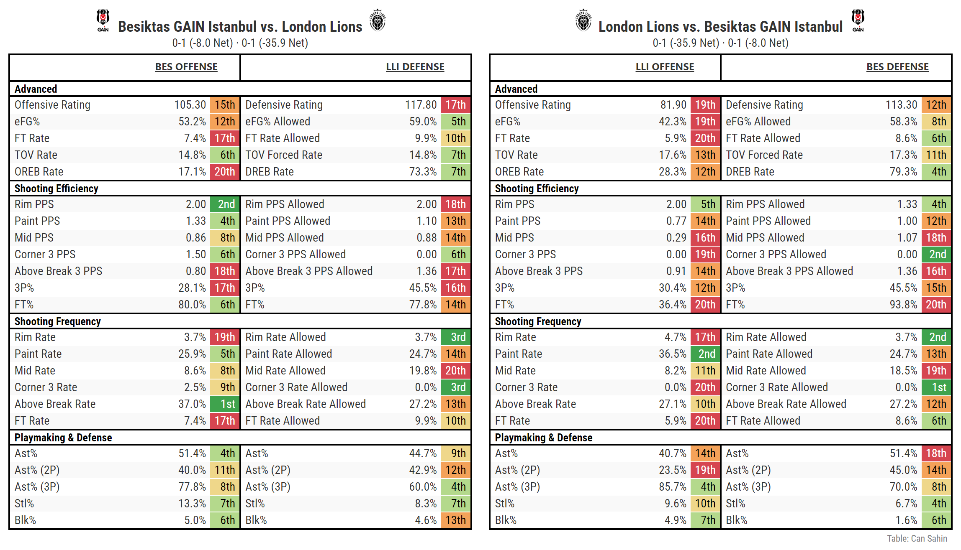
Team Matchup Cheatsheet
2025-26 EuroCup Regular Season
Key Matchups
Corner 3 PPS:
BES offense: 2 PPS (6th most efficiency in EC)
LLI defense: 0 PPS Allowed (6th best)
Rim PPS:
LLI offense: 2 PPS (5th most)
BES defense: 1.33 Allowed (4th best)

Slide 3
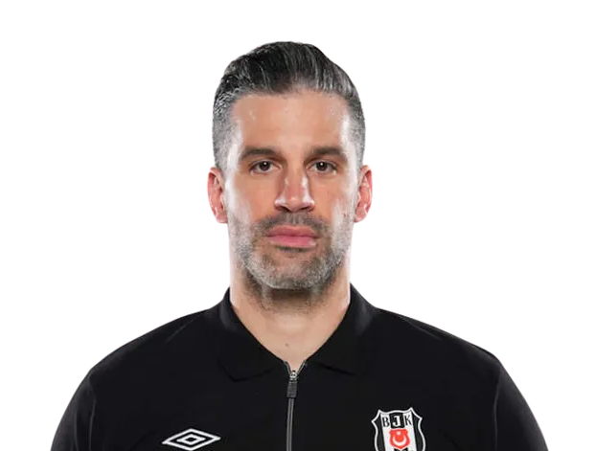
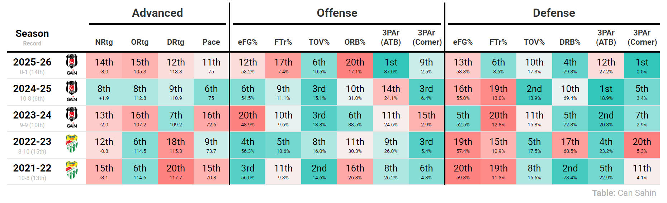
Key Rankings of Dusan Alimpijevic Coached Teams (EuroCup)
As of October 3, 2025
Trends Across Seasons
Offensive identity: Low turnovers, increasing 3-point volume (especially ATB), but inconsistent shooting efficiency and rebounding.
Defensive identity: Good rebounding, some years forcing high turnovers, but inconsistent shot defense.

Slide 4
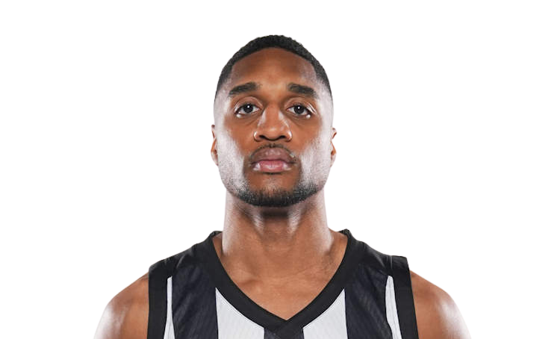
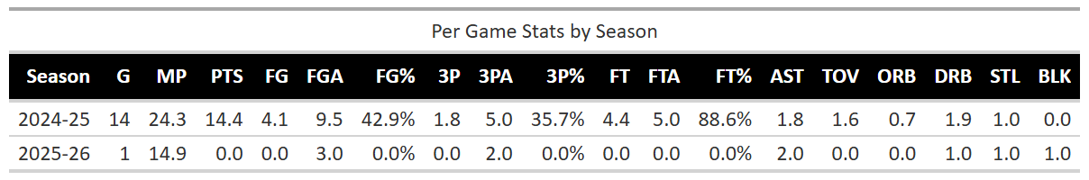
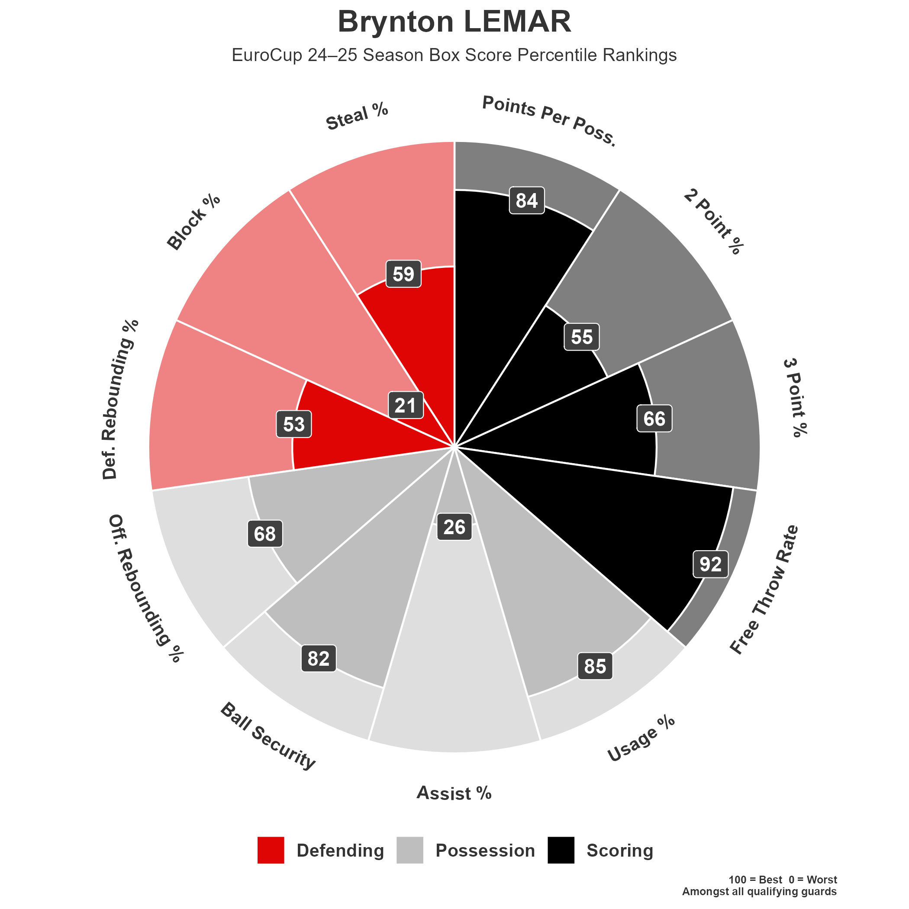
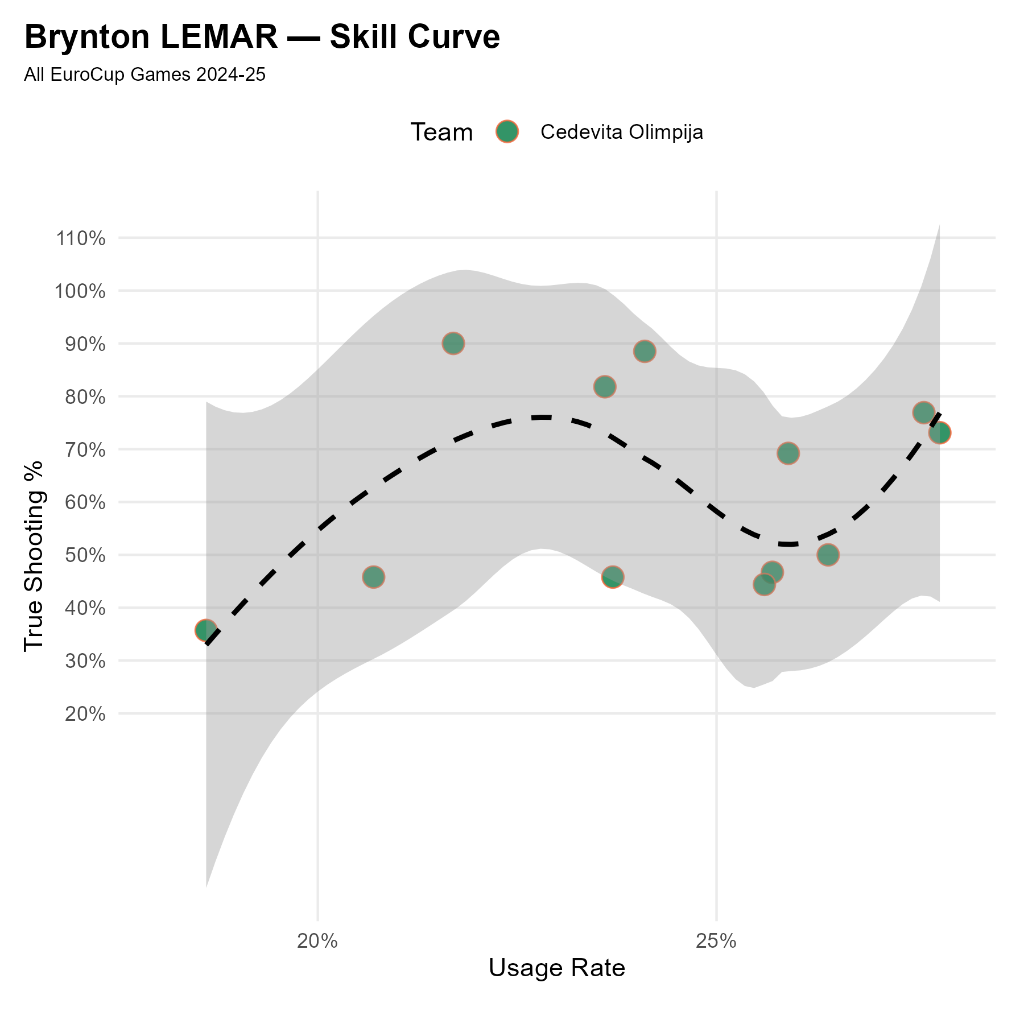
Brynton LEMAR | PG | #11
Profile
2024/25 Box Score Percentile Rankings

Slide 5
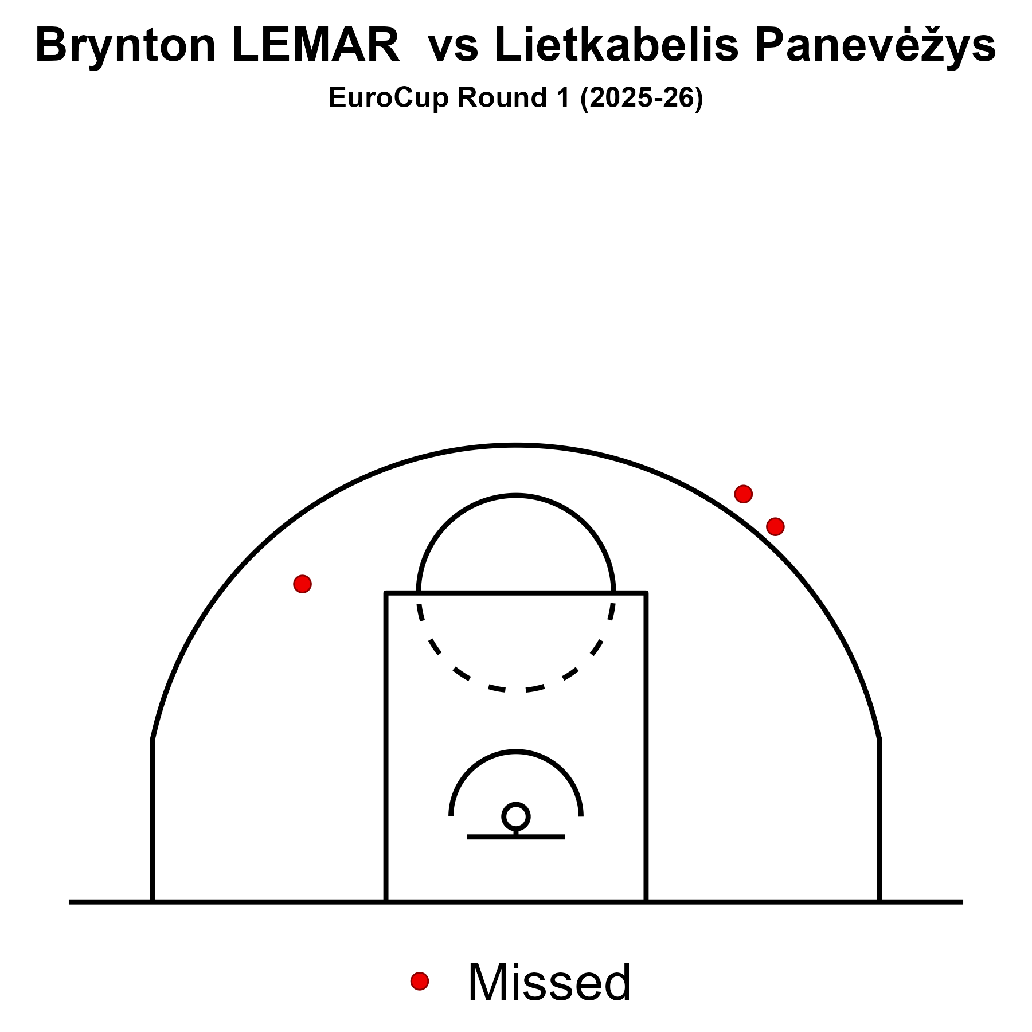
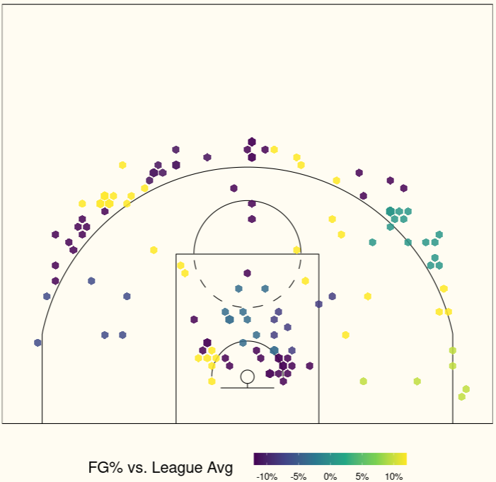
Brynton LEMAR | PG | #11
Shooting Charts
EuroCup 2024/25

Slide 6
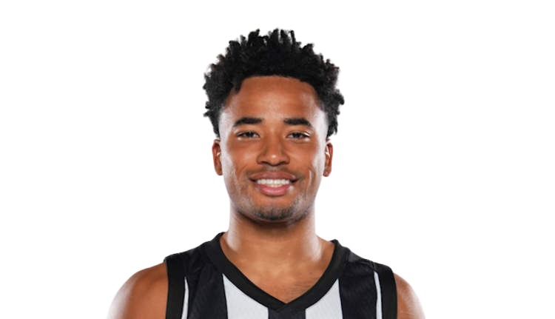
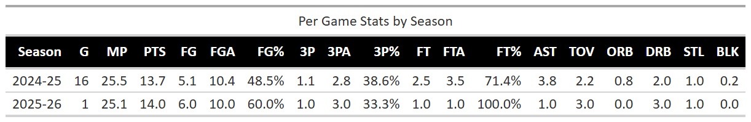
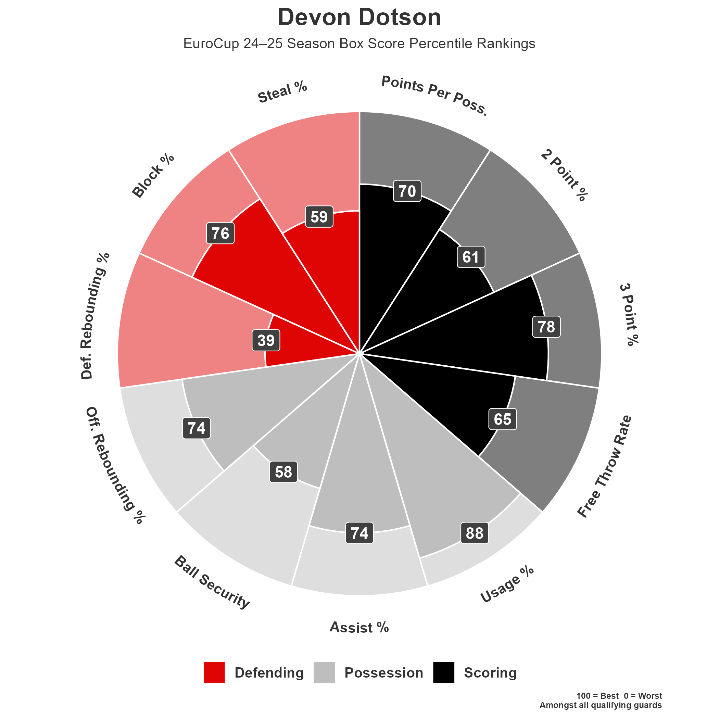
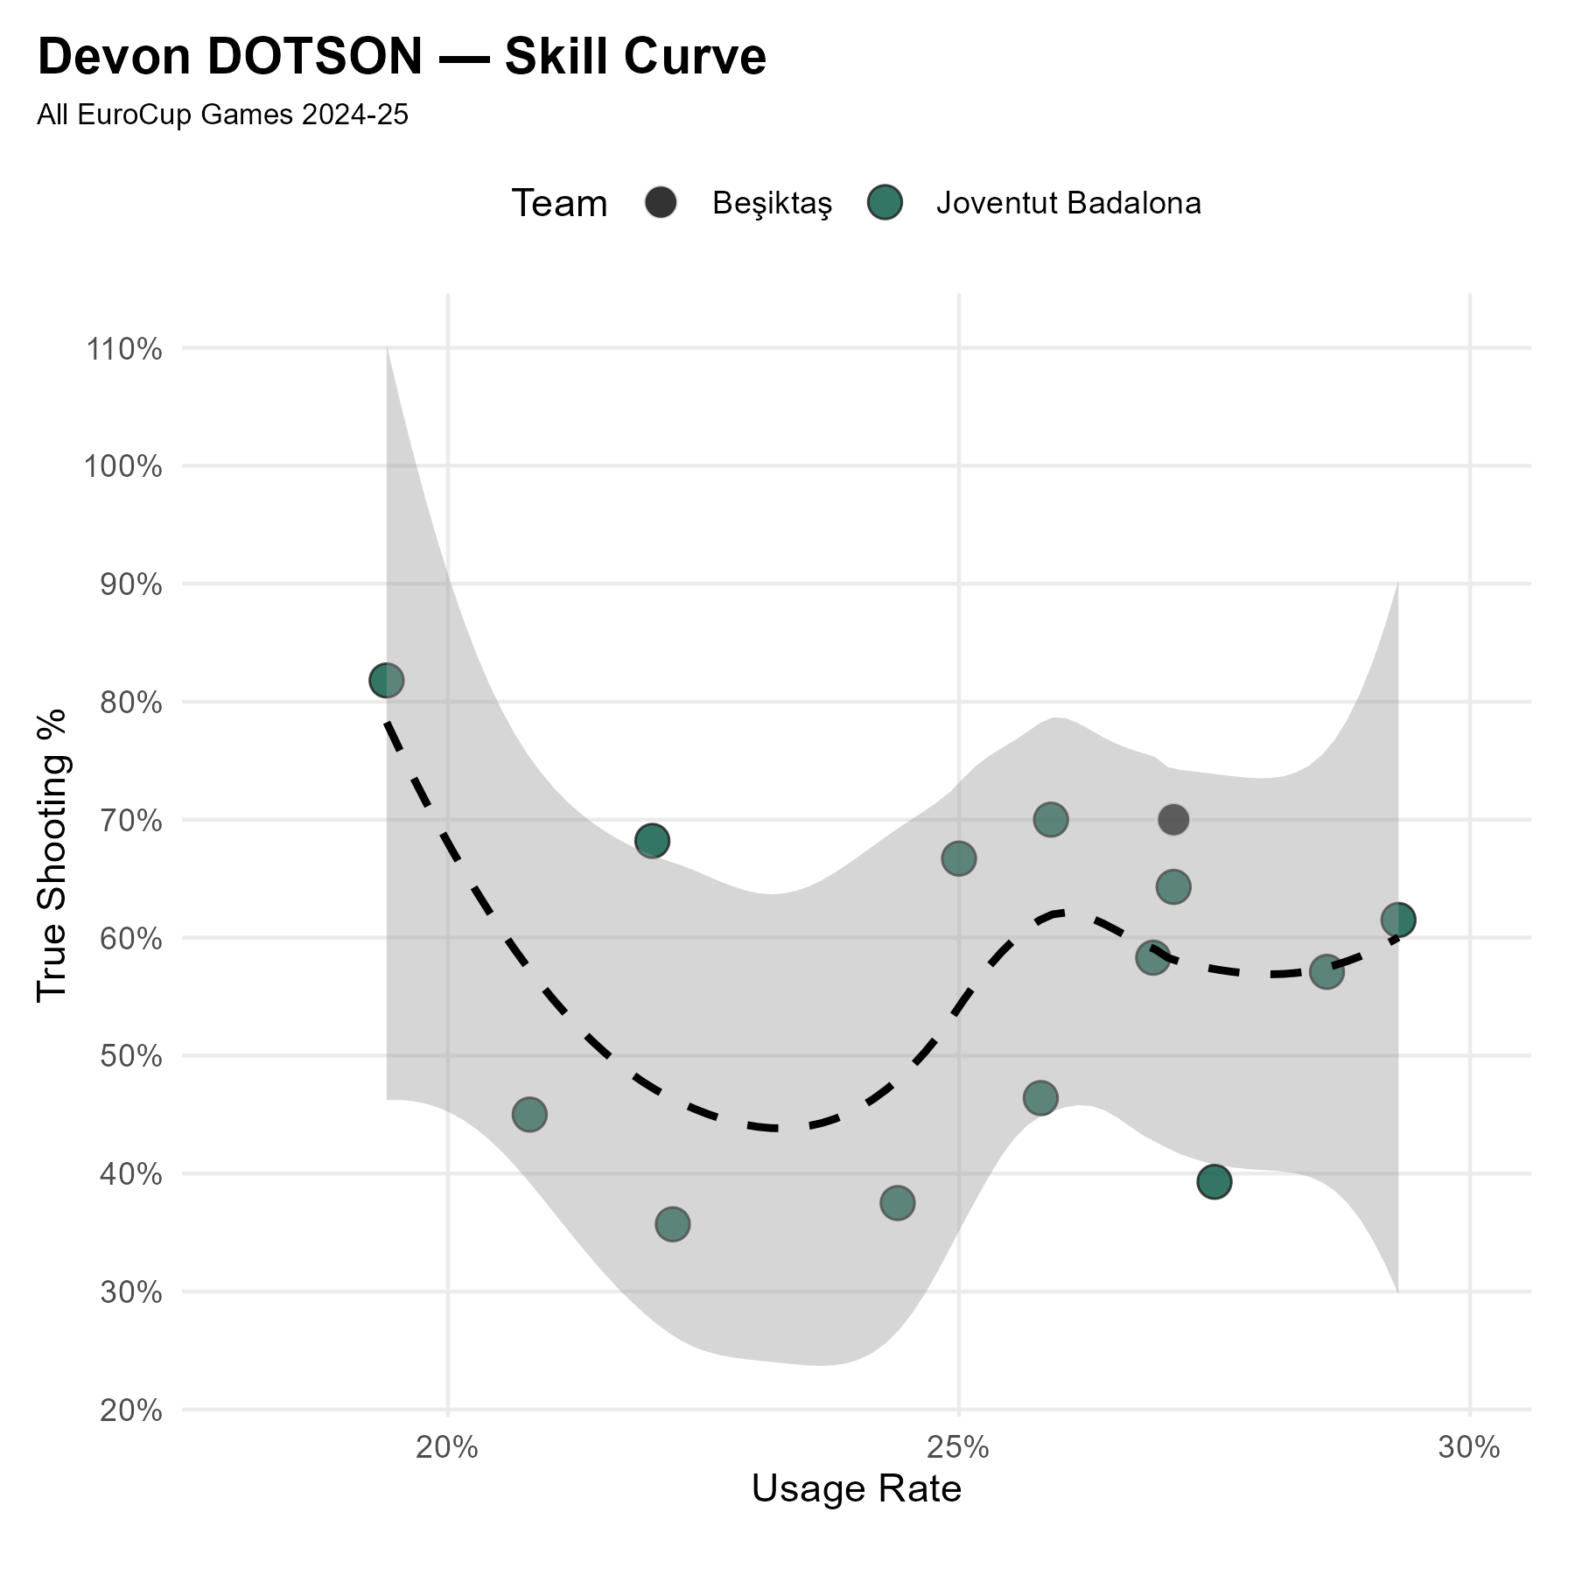
Devon DOTSON | SG | #1
Profile
2024/25 Box Score Percentile Rankings

Slide 7
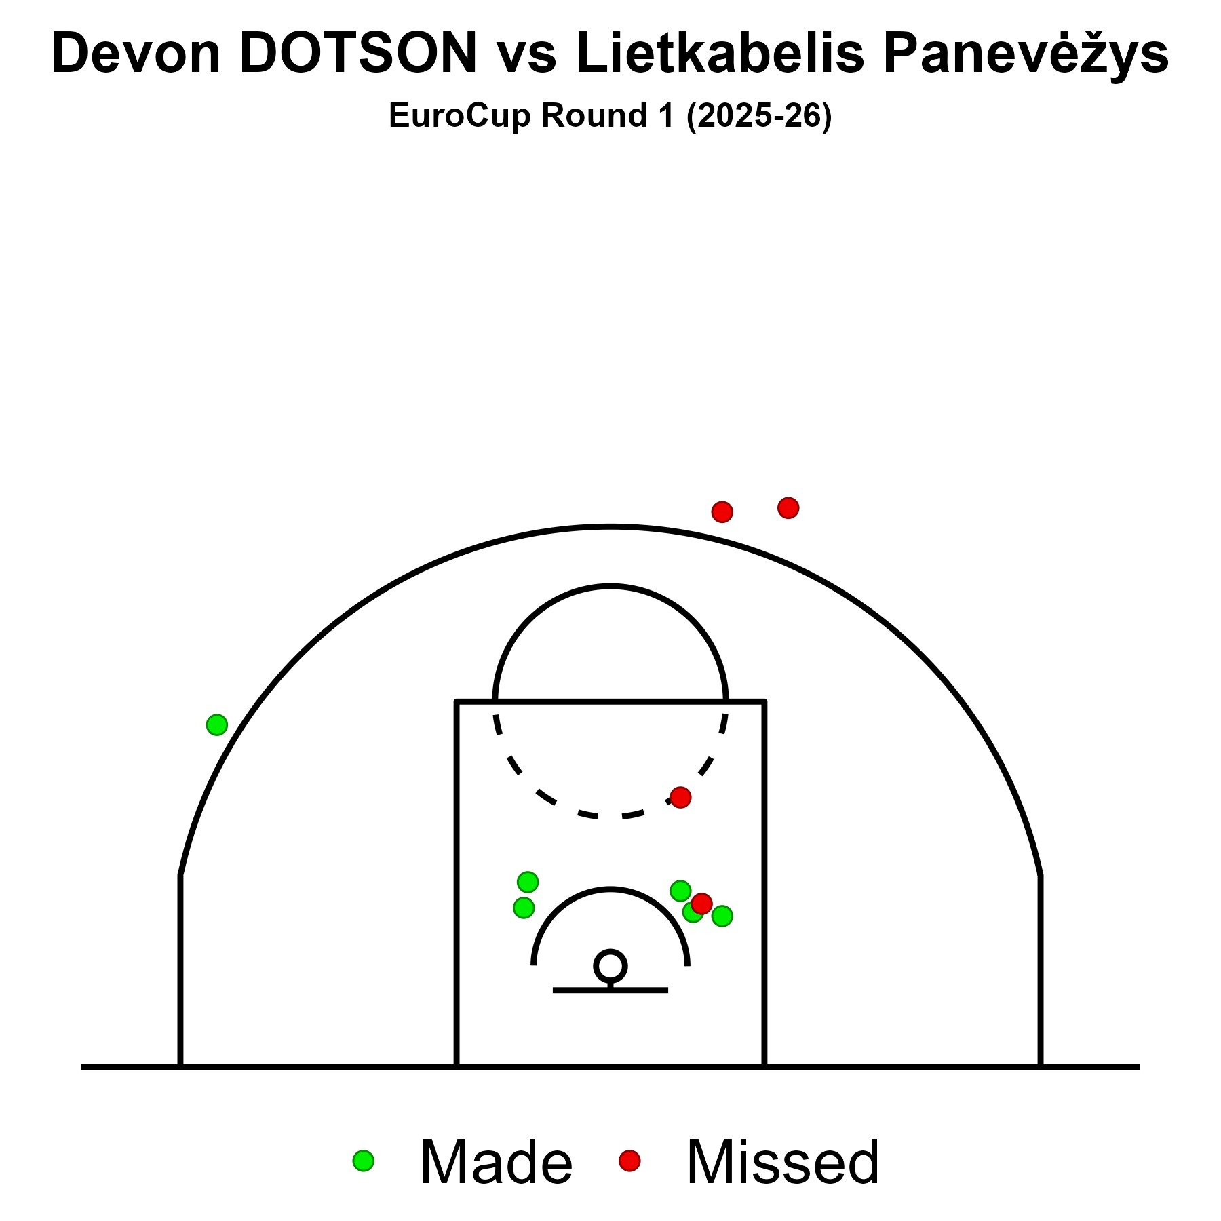
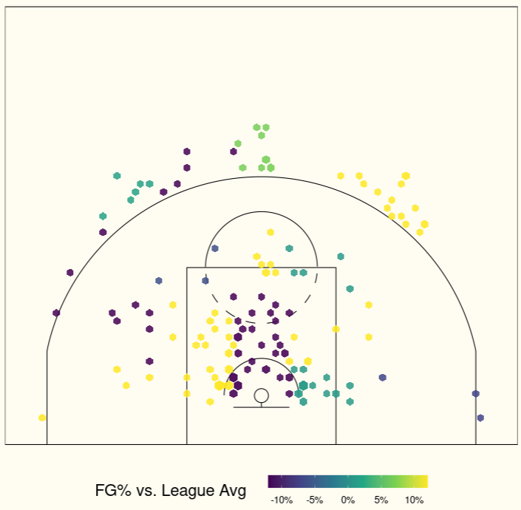
Devon DOTSON | SG | #1
Shooting Charts
EuroCup 2024/25

Slide 8
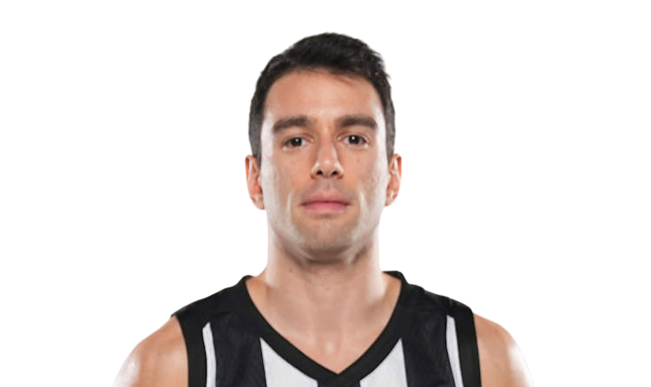
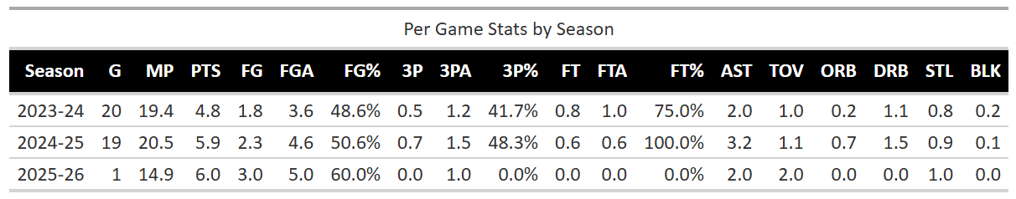
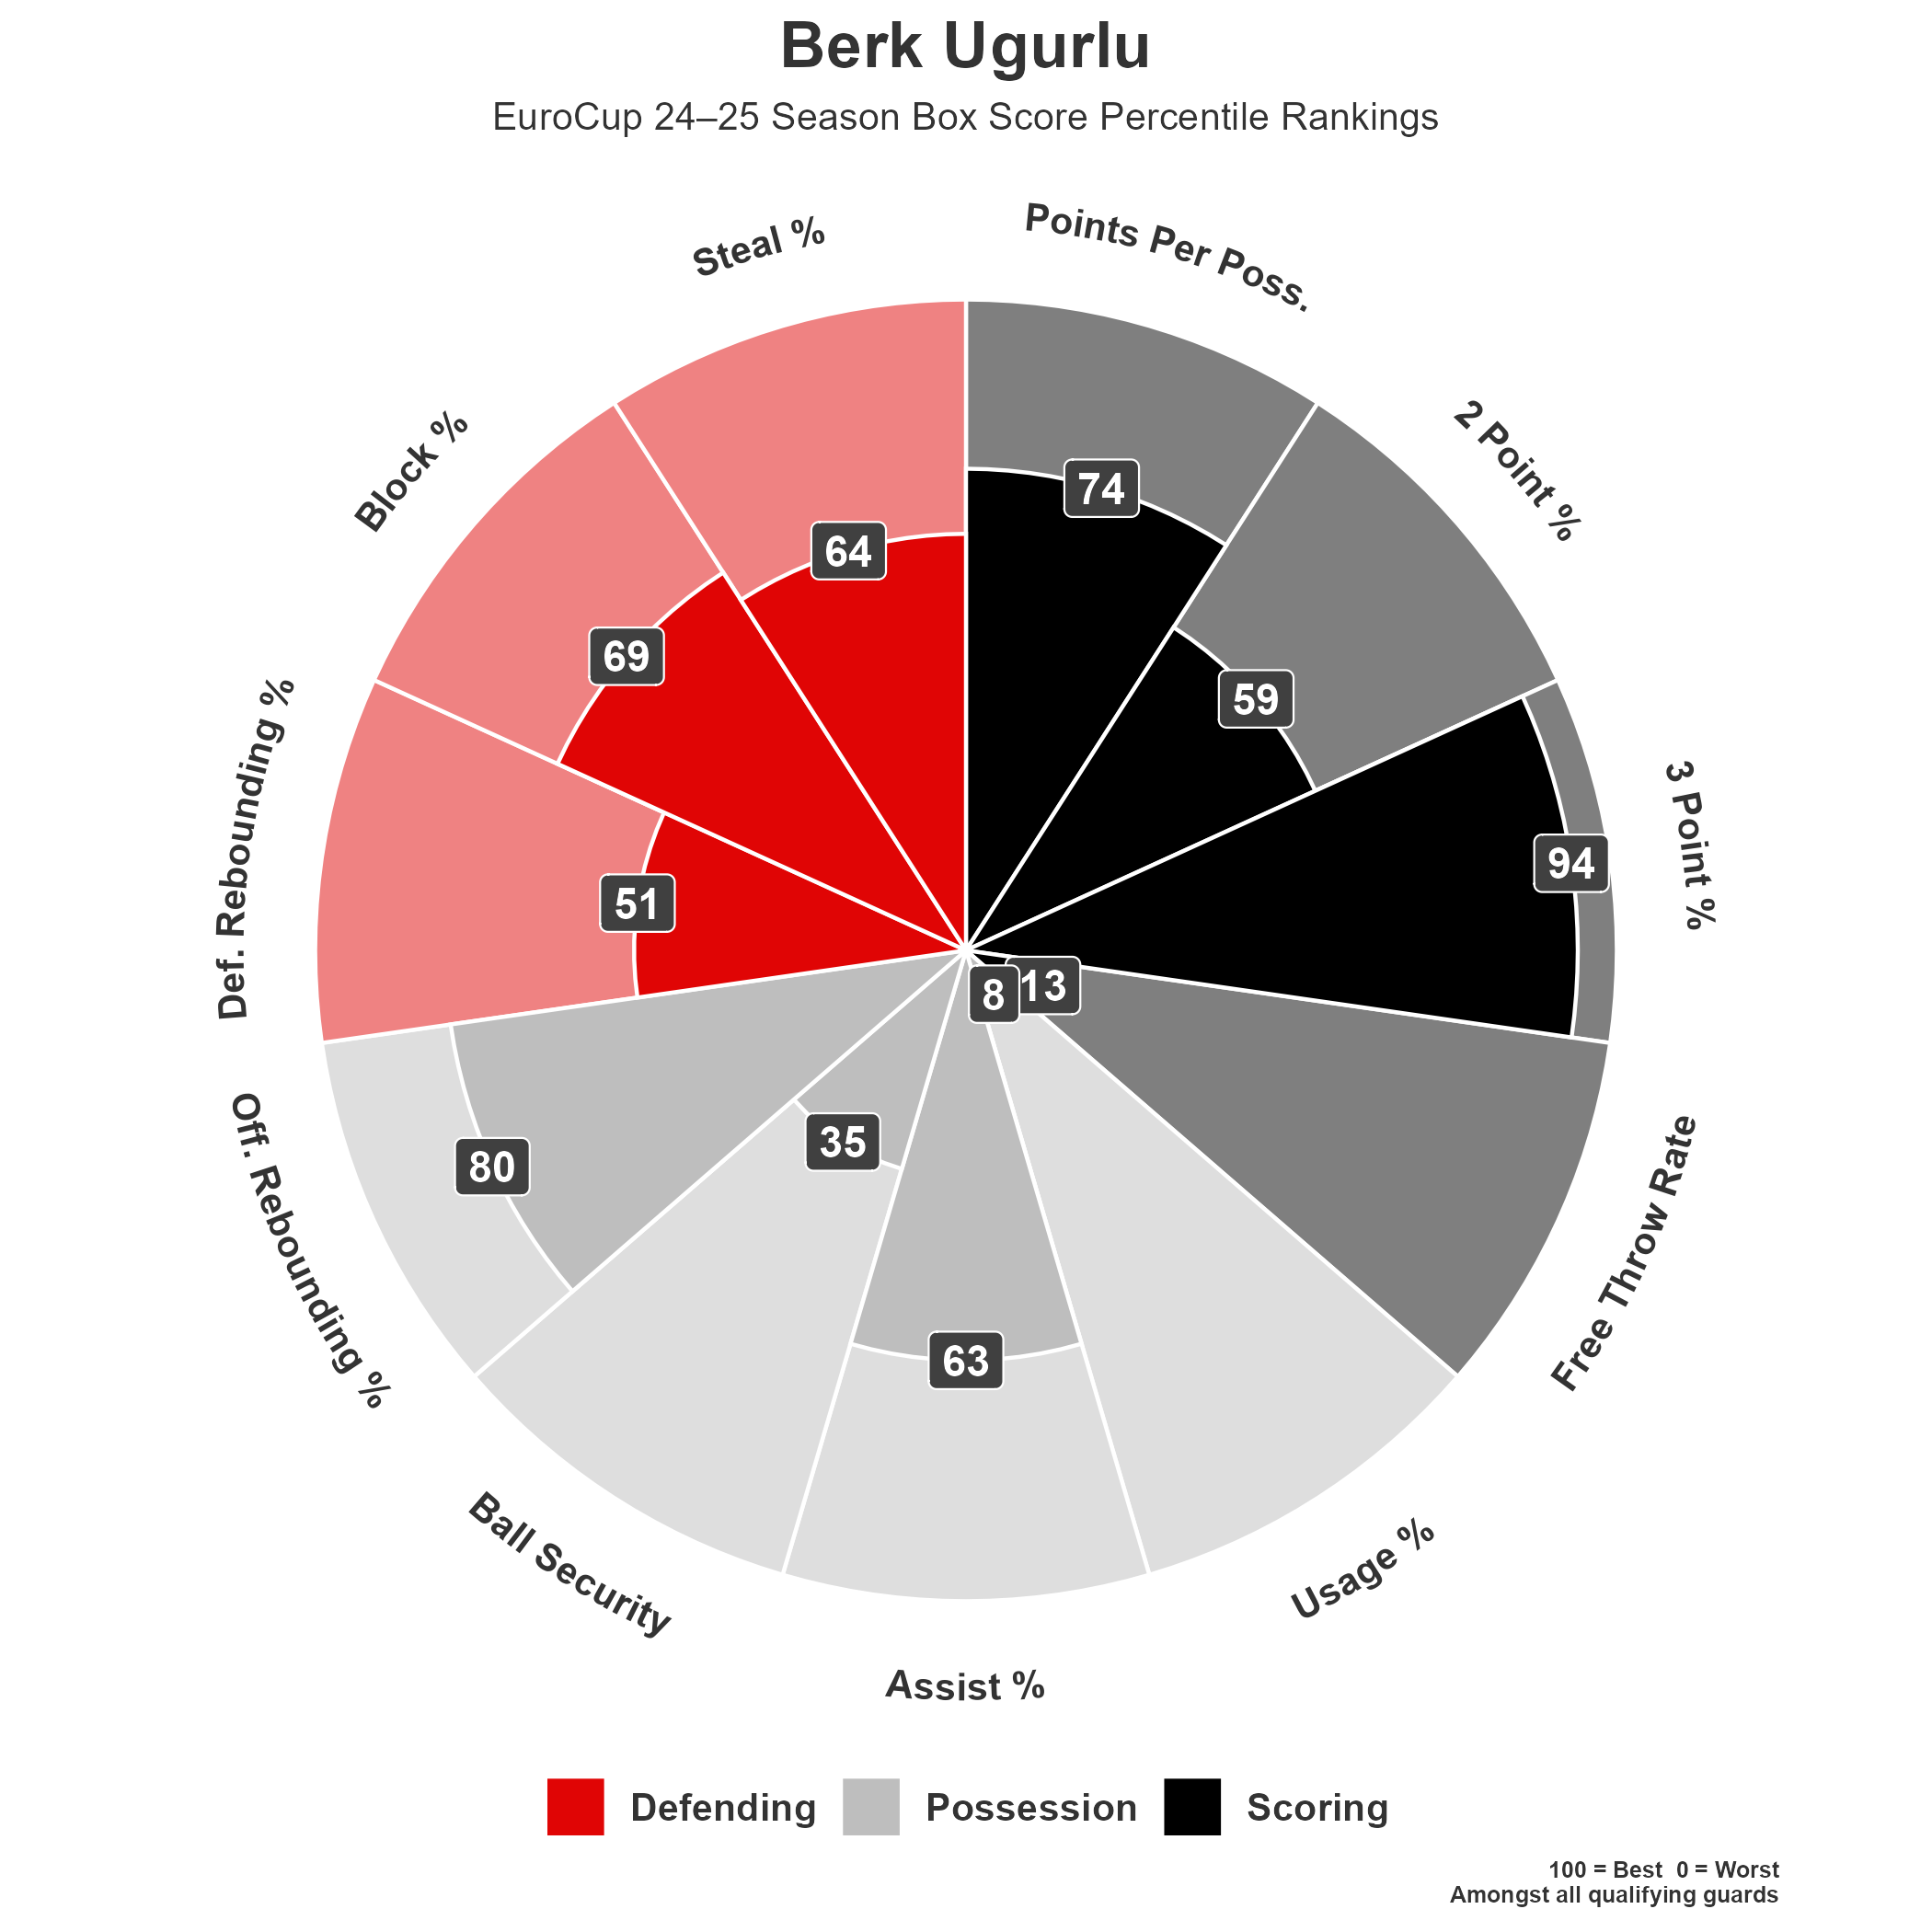
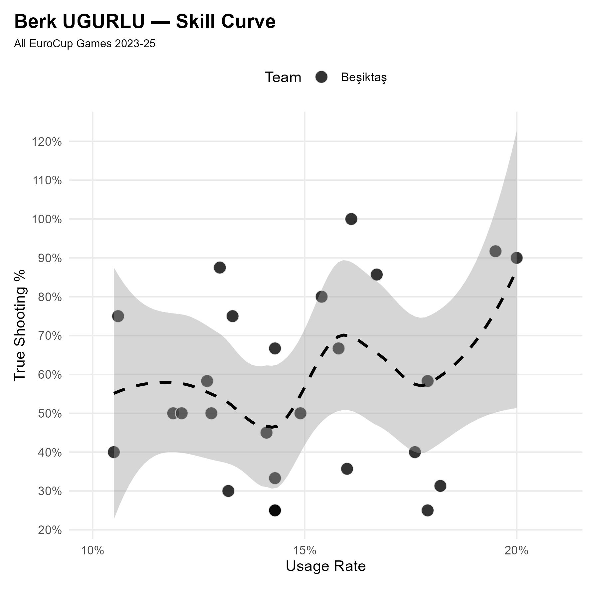
Berk UGURLU | SG | #6
Profile
2024/25 Box Score Percentile Rankings

Slide 9
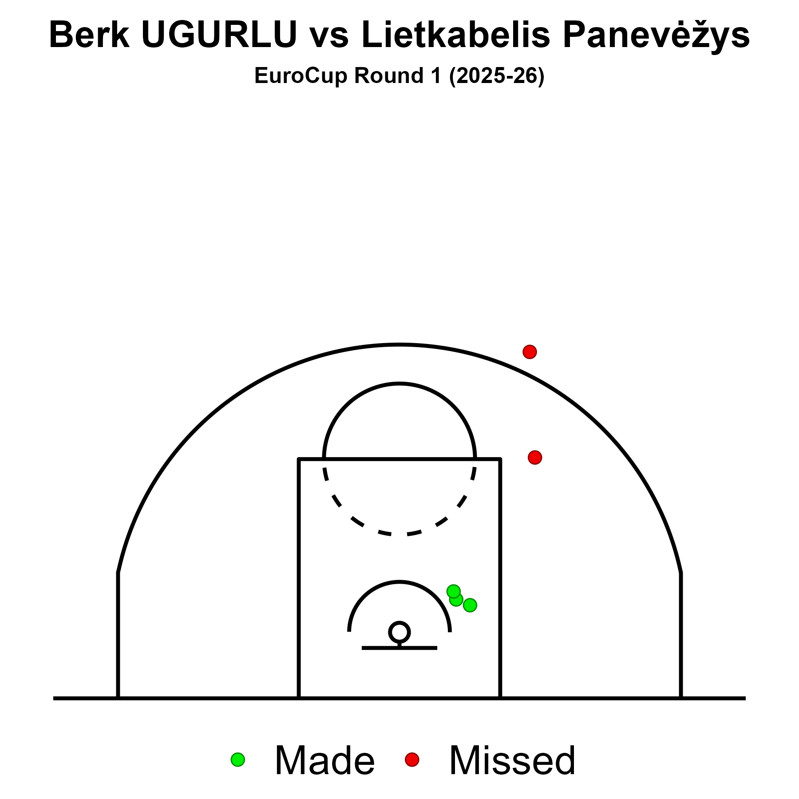
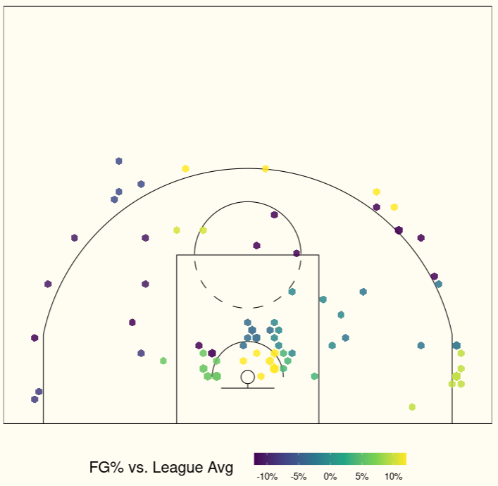
Berk UGURLU | SG | #6
Shooting Charts
EuroCup 2024/25

Slide 10
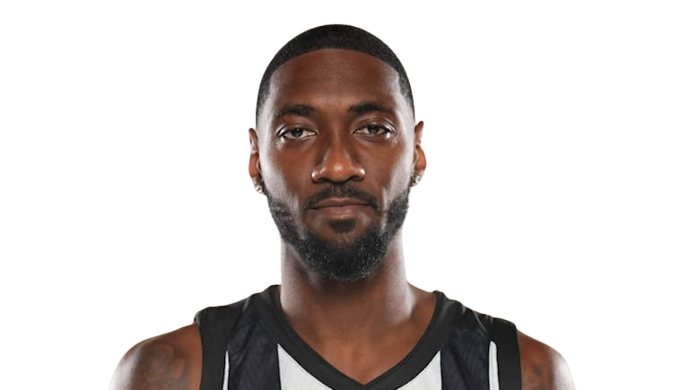
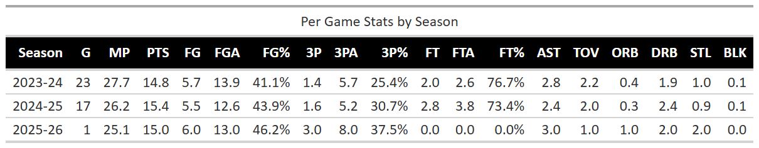
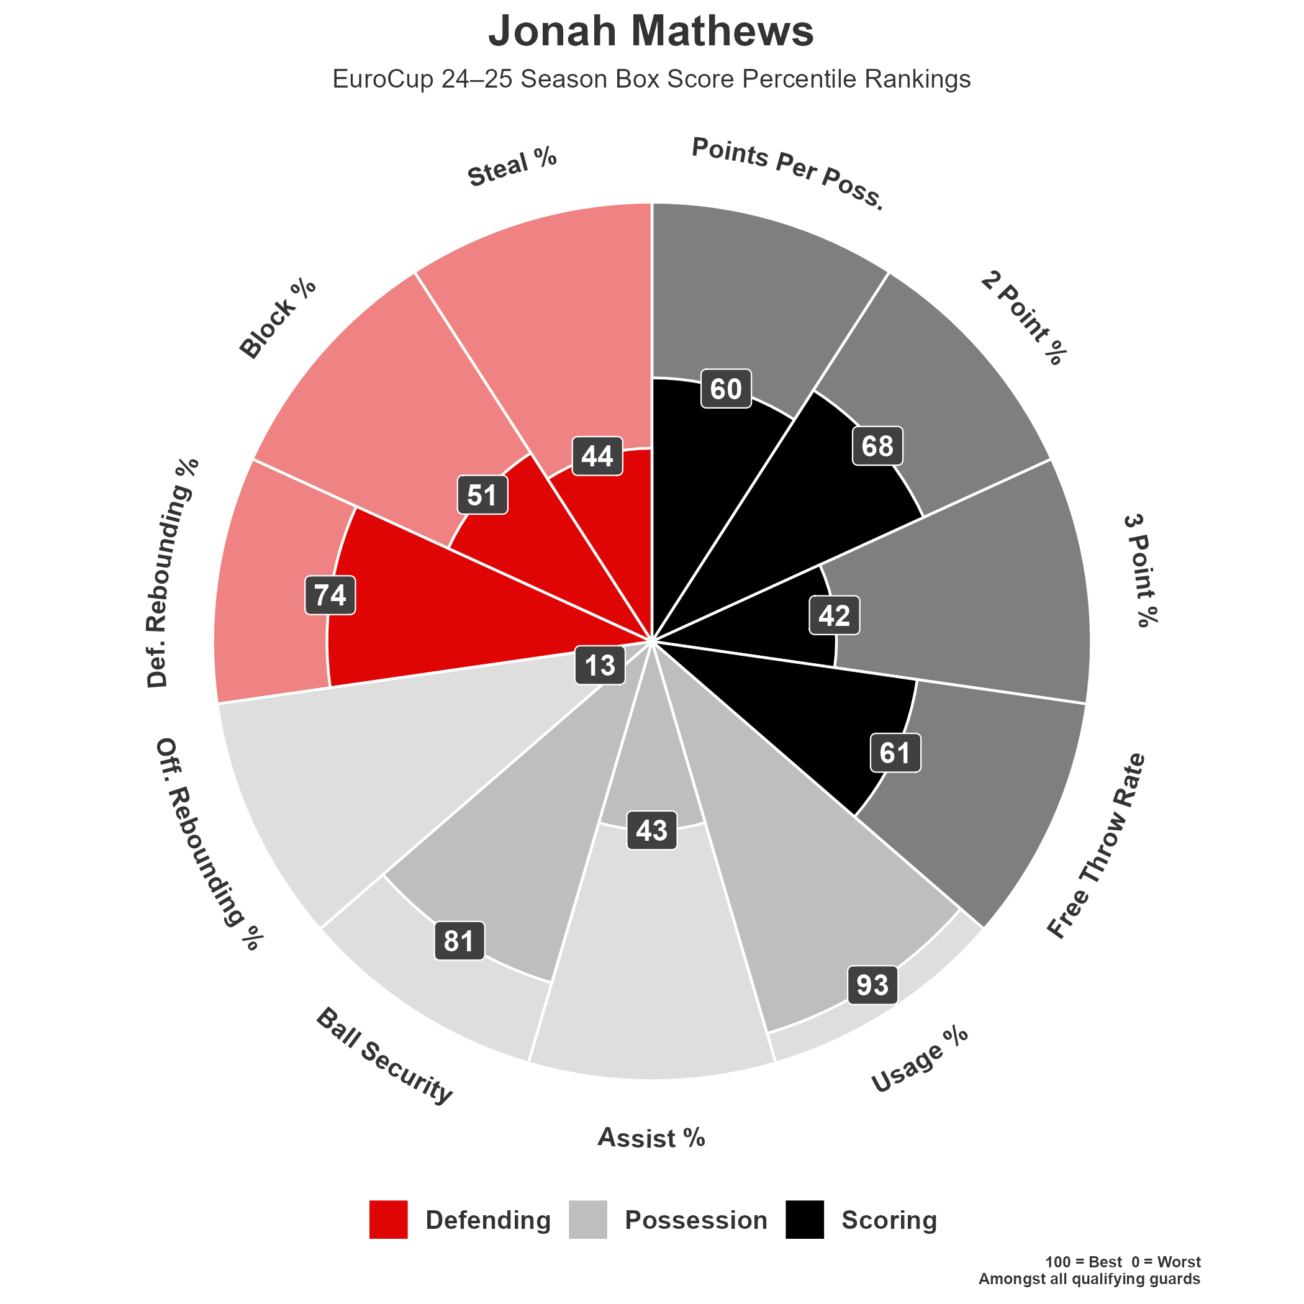
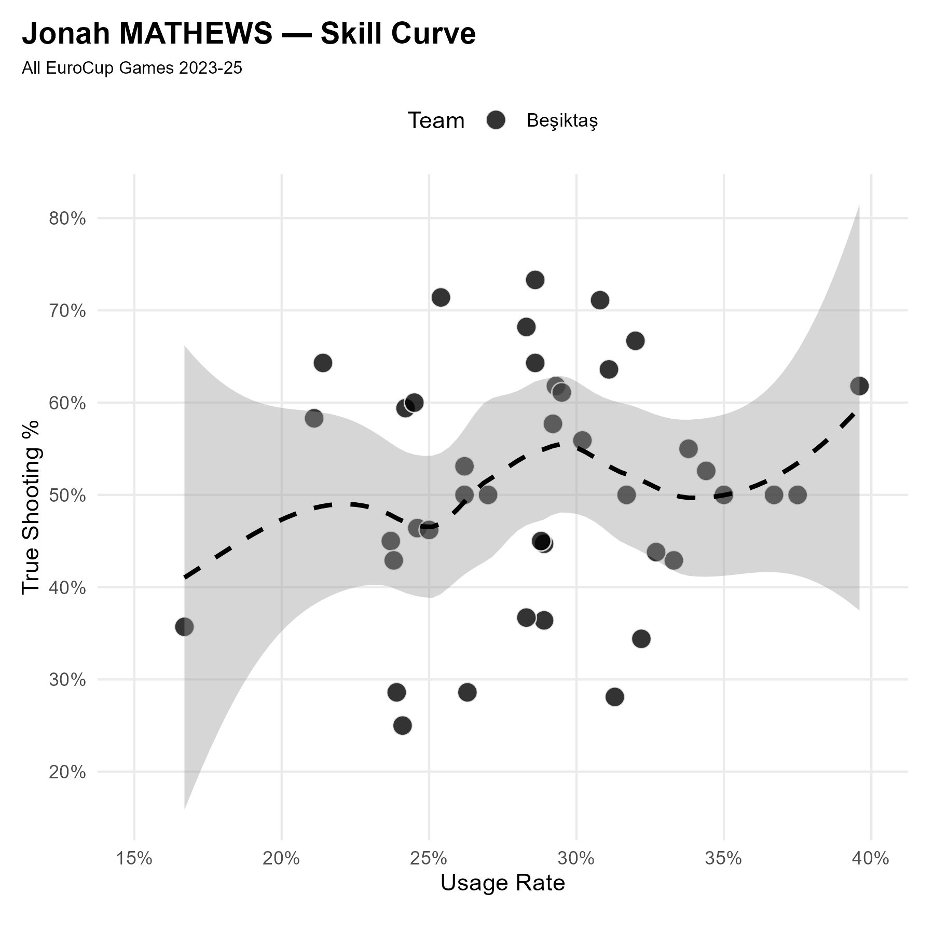
Jonah MATHEWS | SG/F | #0
Profile
2024/25 Box Score Percentile Rankings

Slide 11
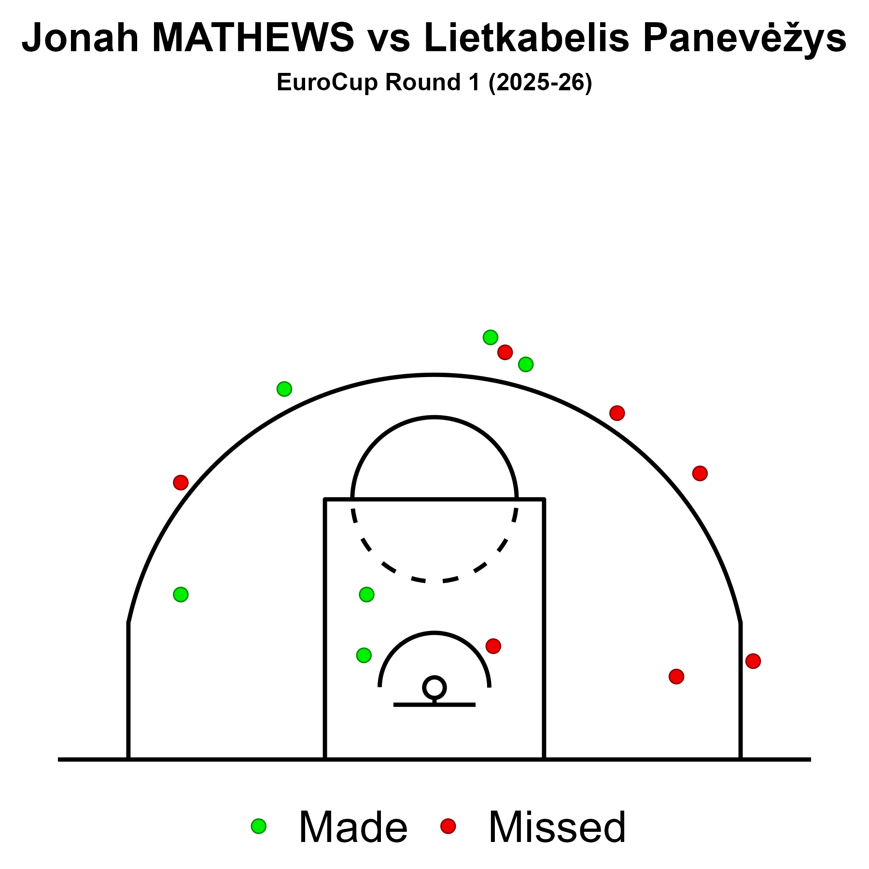
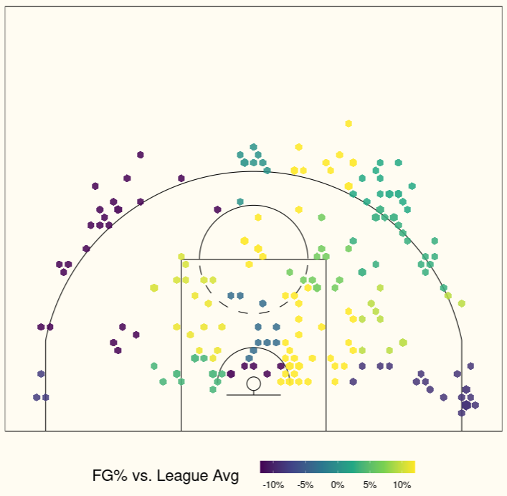
Jonah MATHEWS | SG/F | #0
Shooting Charts
EuroCup 2024/25

Slide 12
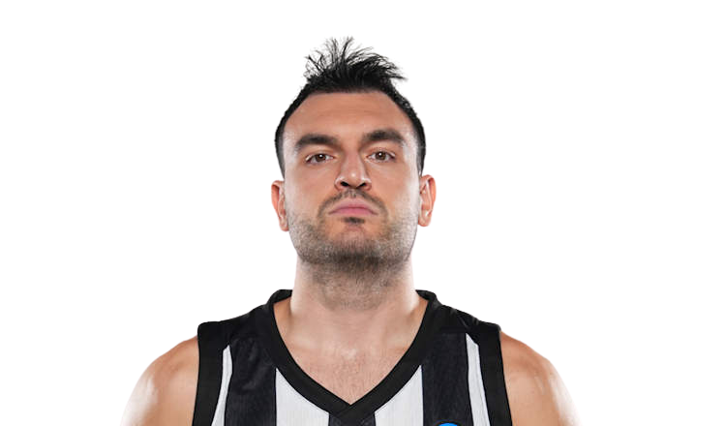
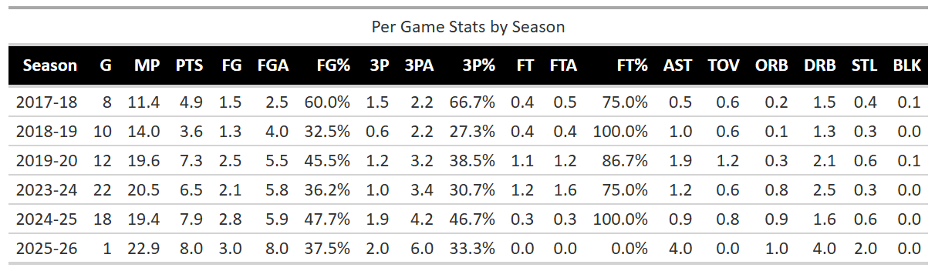
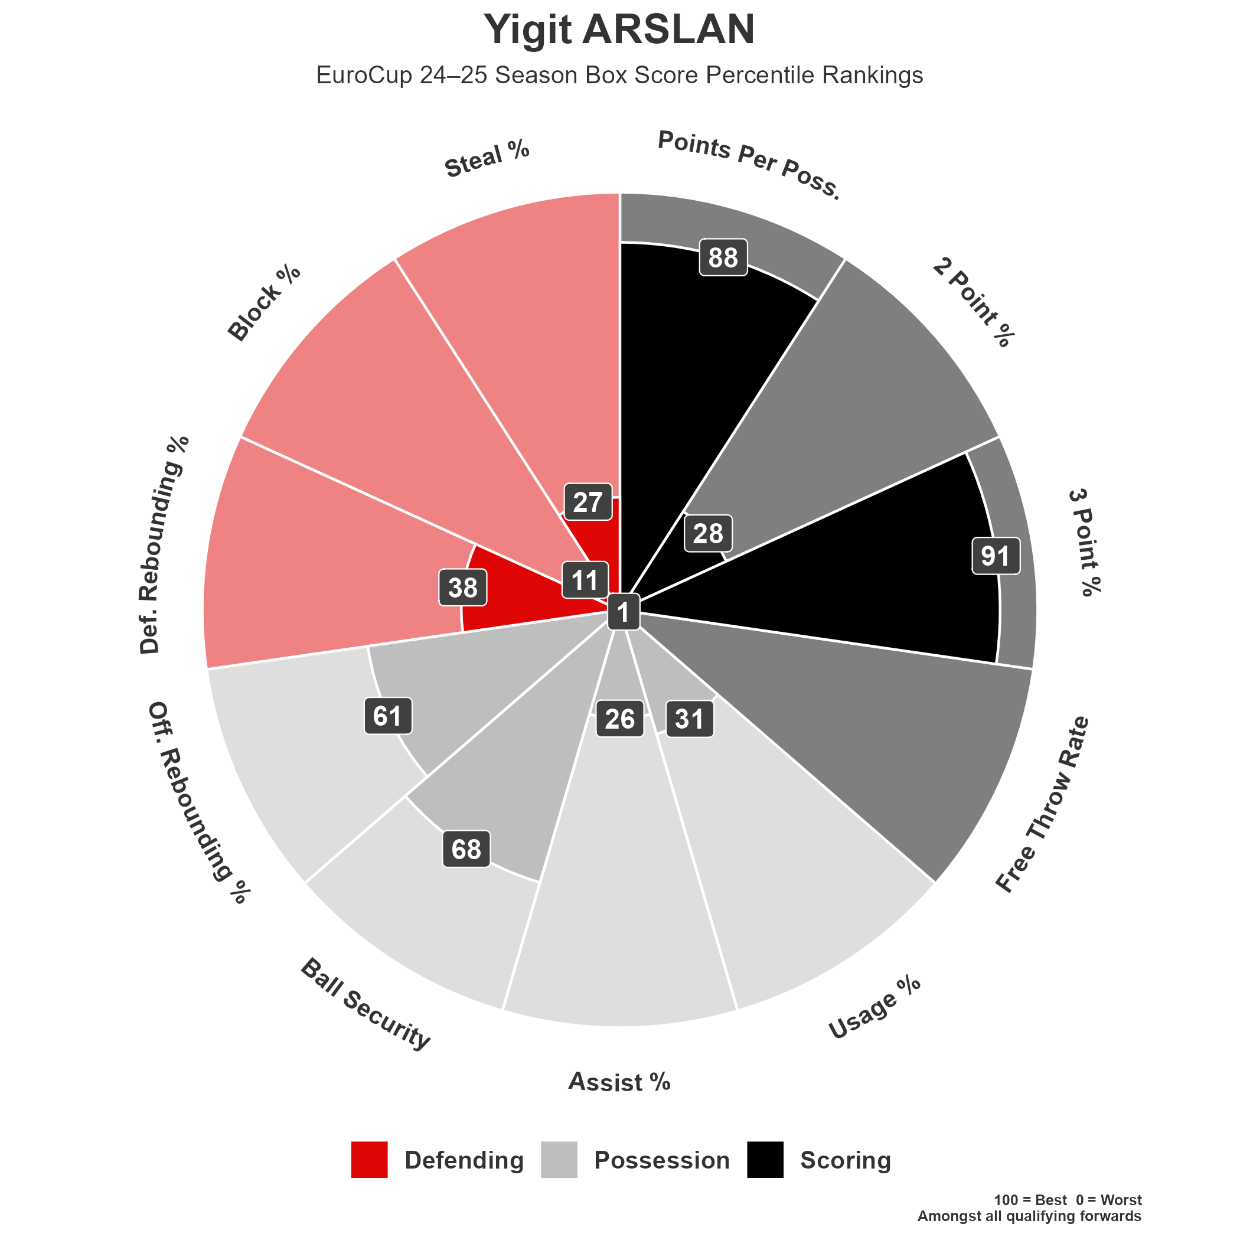
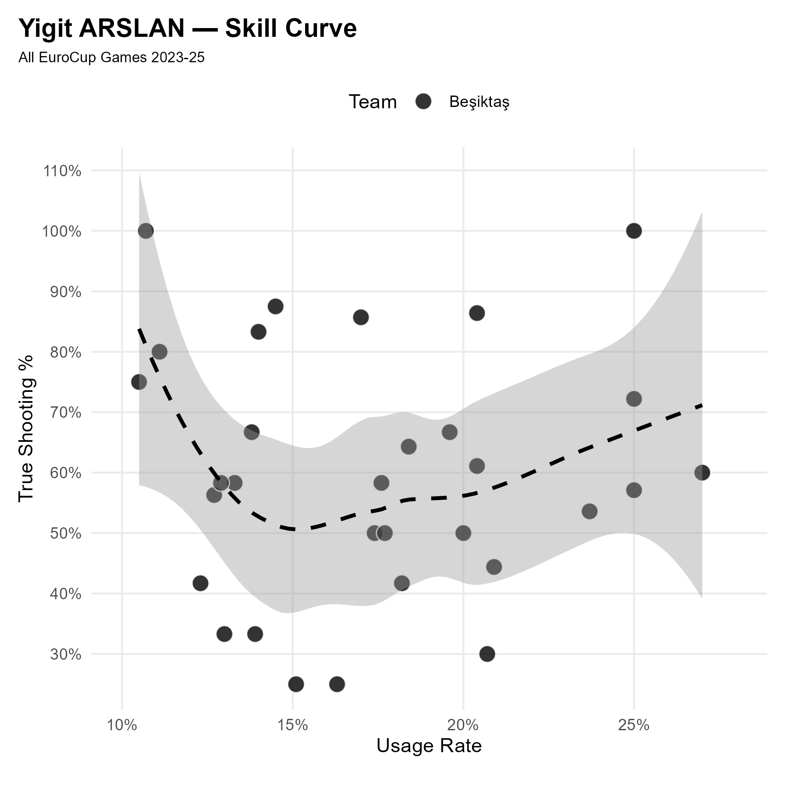
Yigit ARSLAN | F | #7
Profile

Slide 13
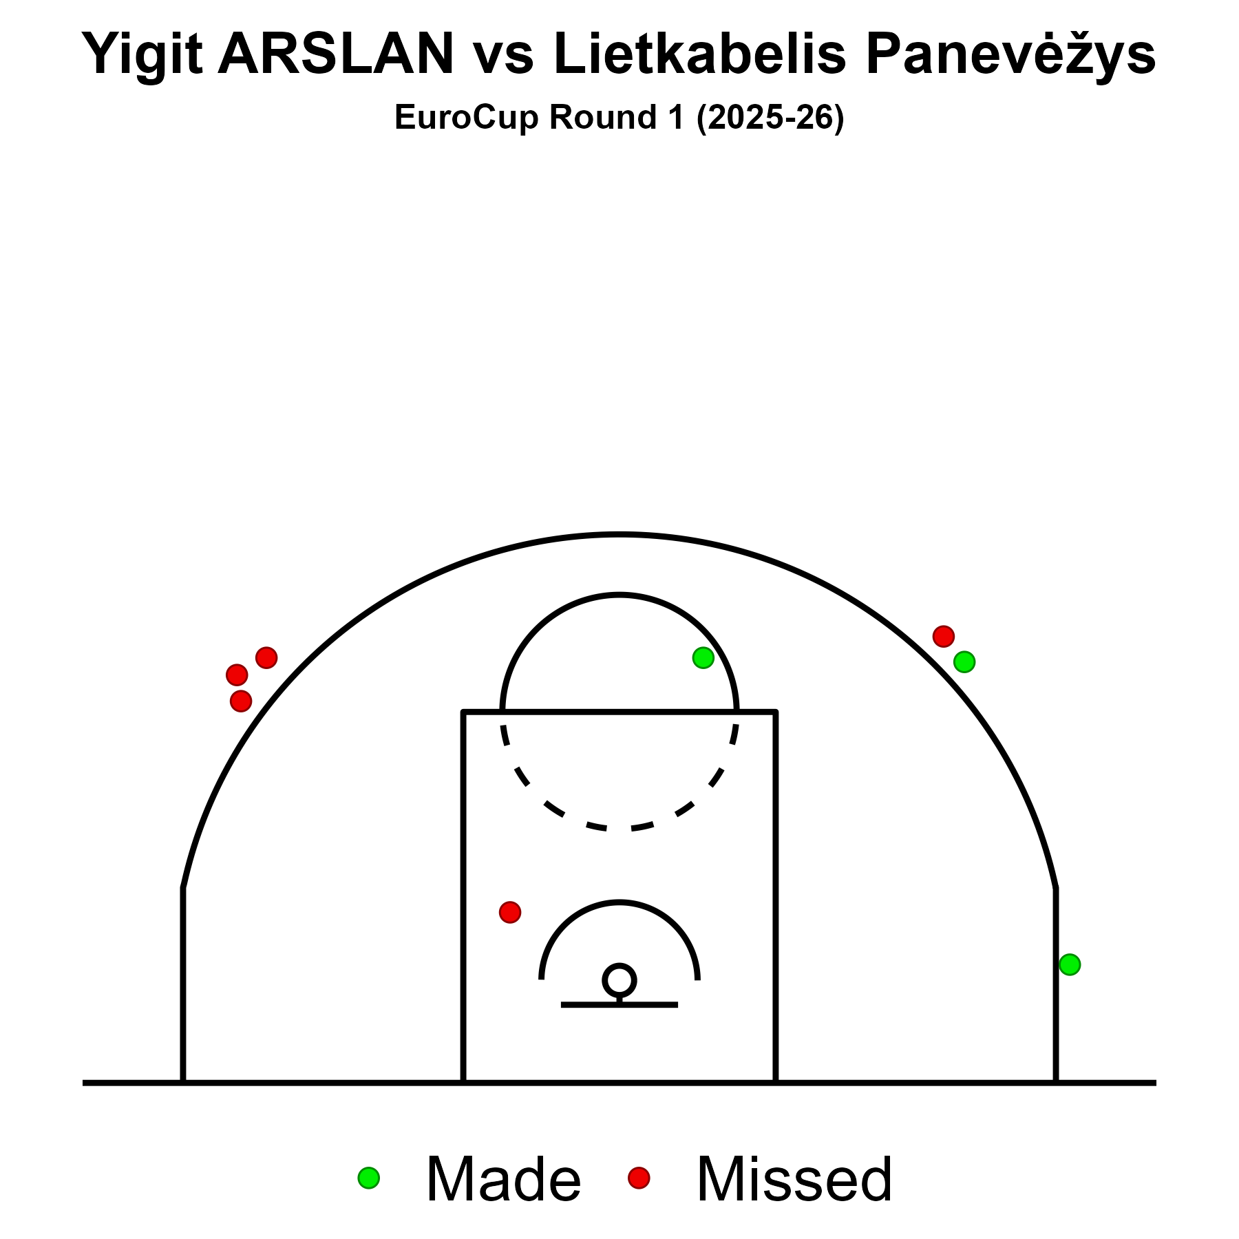
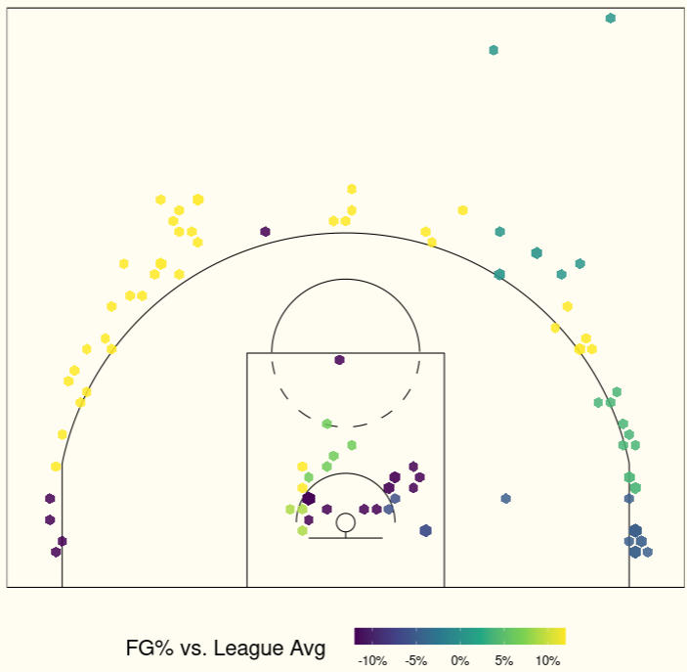
Yigit ARSLAN | F | #7
Shooting Charts
EuroCup 2024/25

Slide 14
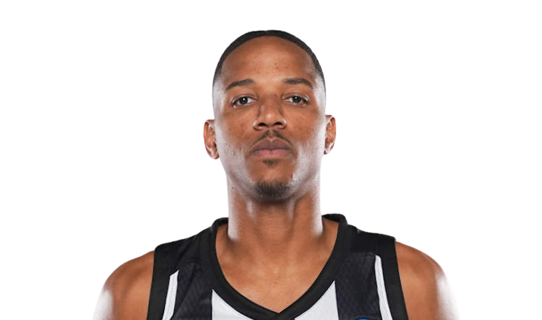
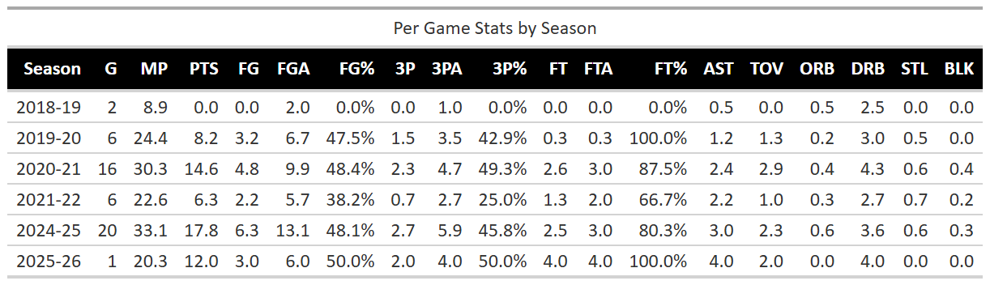
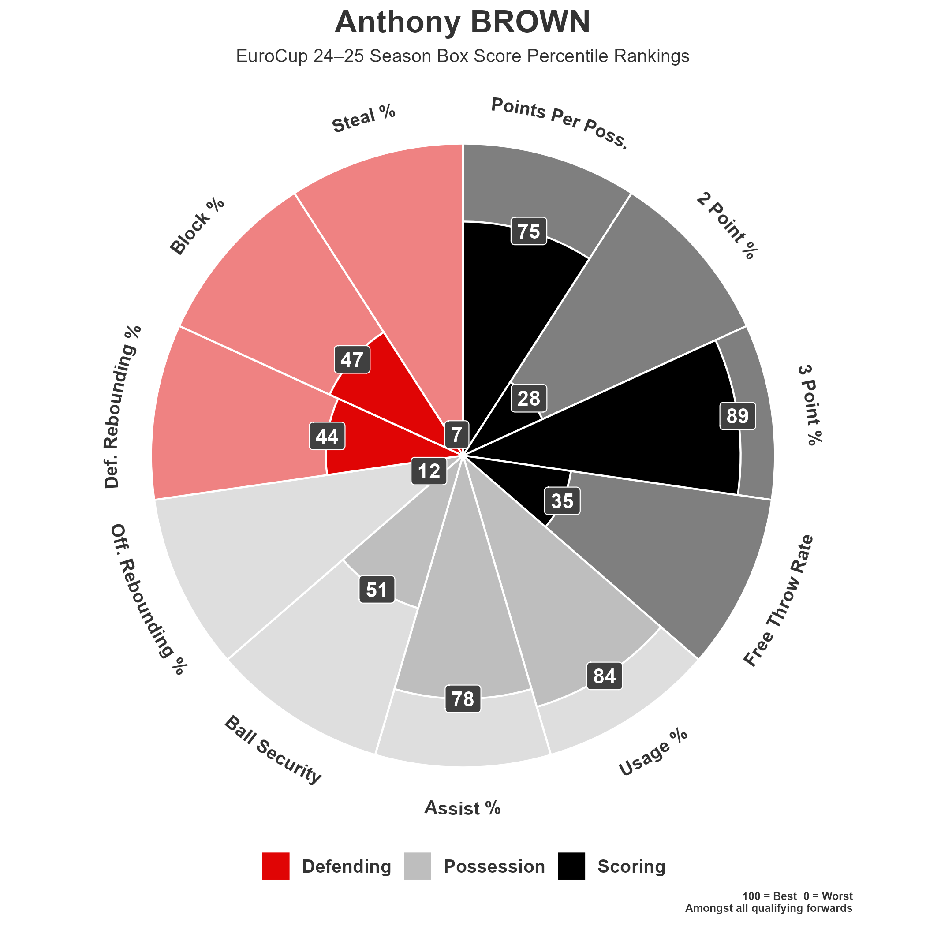
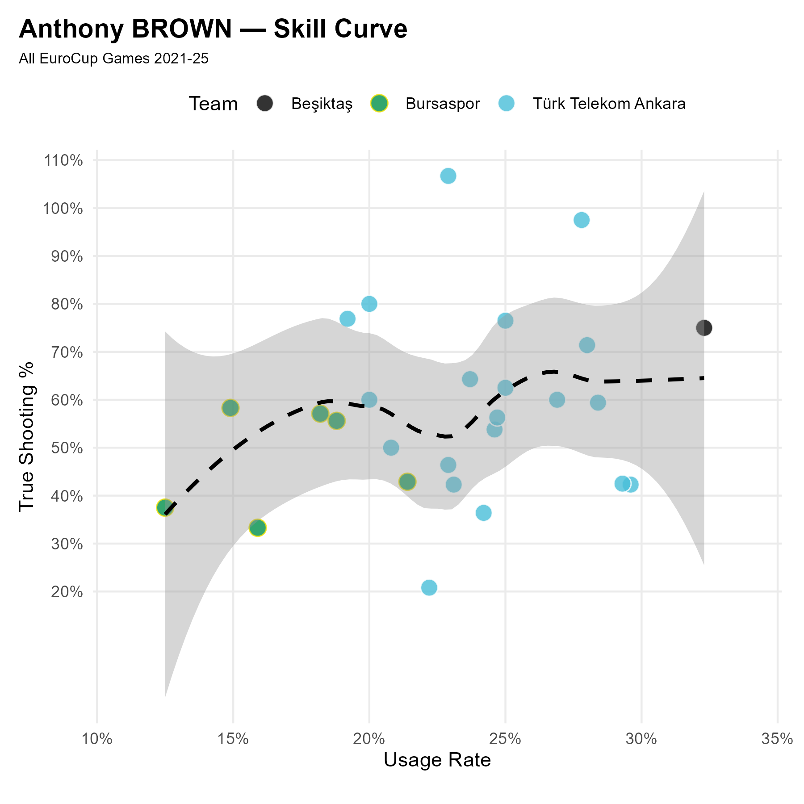
Anthony BROWN | F | #21
Profile

Slide 15
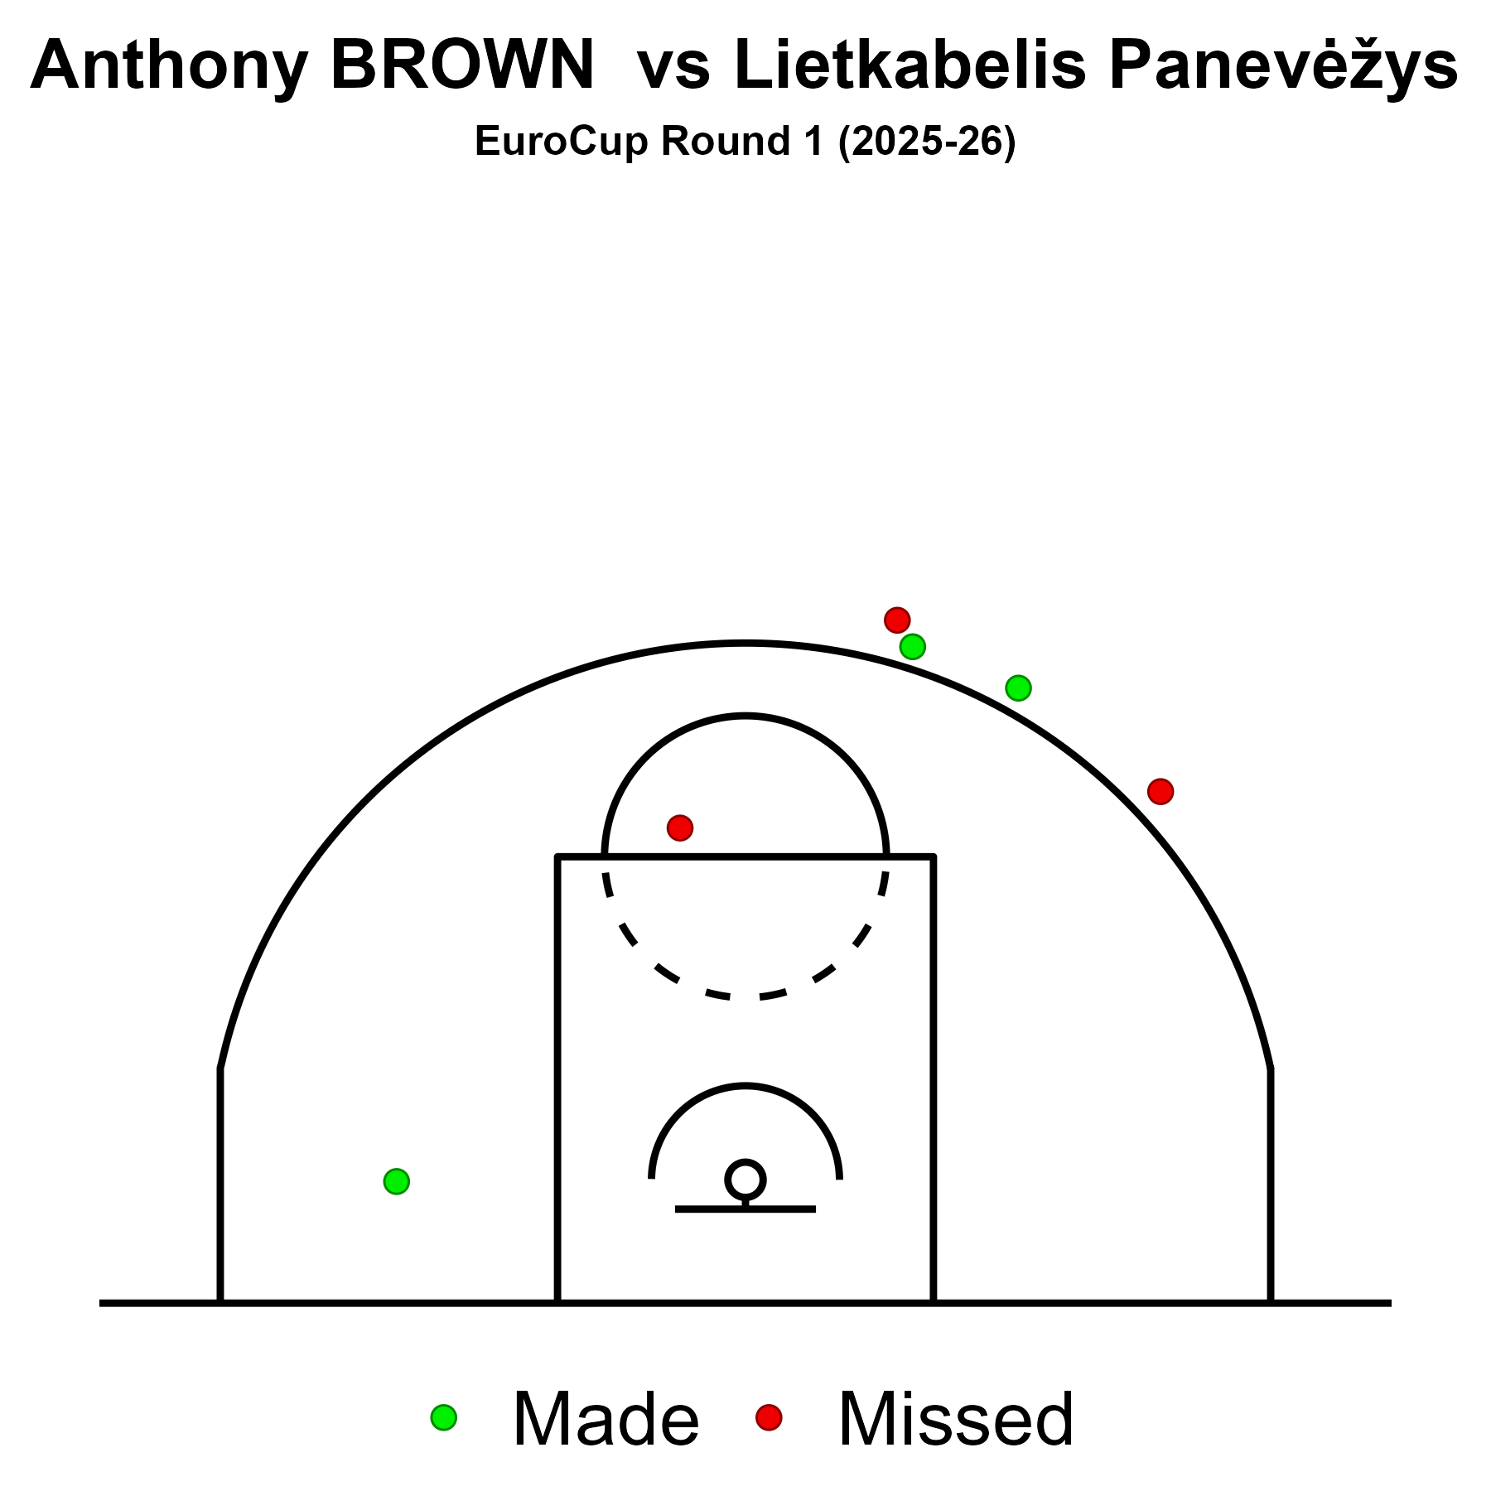
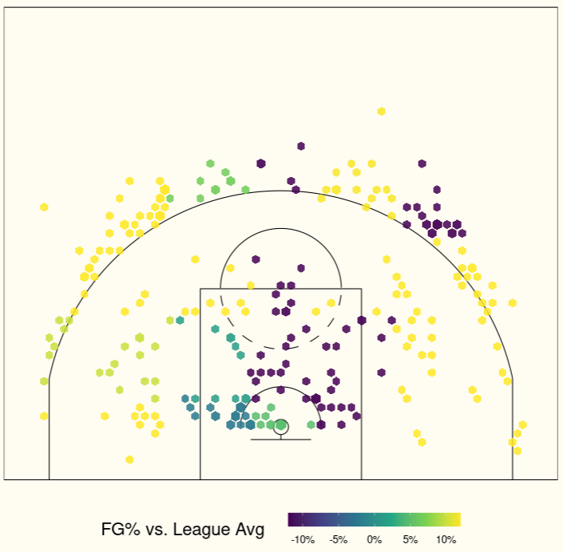
Anthony BROWN | F | #21
Shooting Charts
EuroCup 2024/25

Slide 16
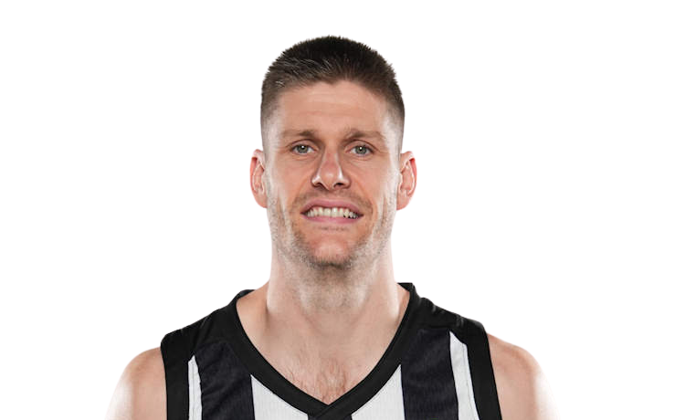
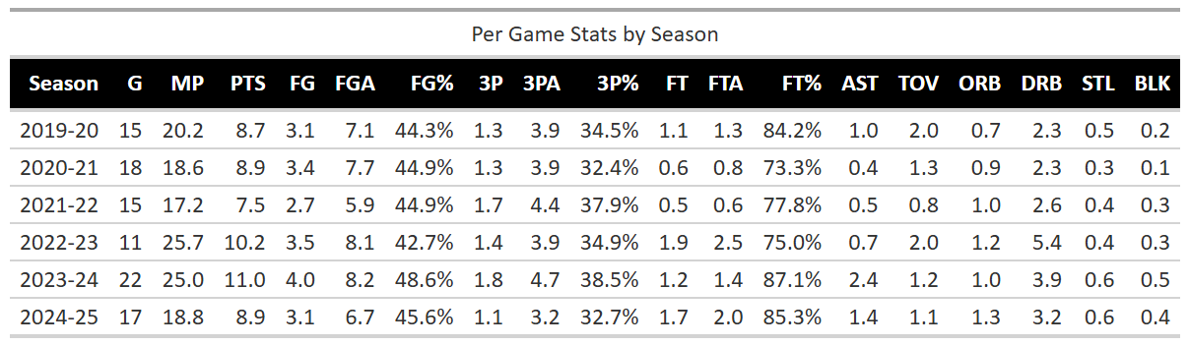
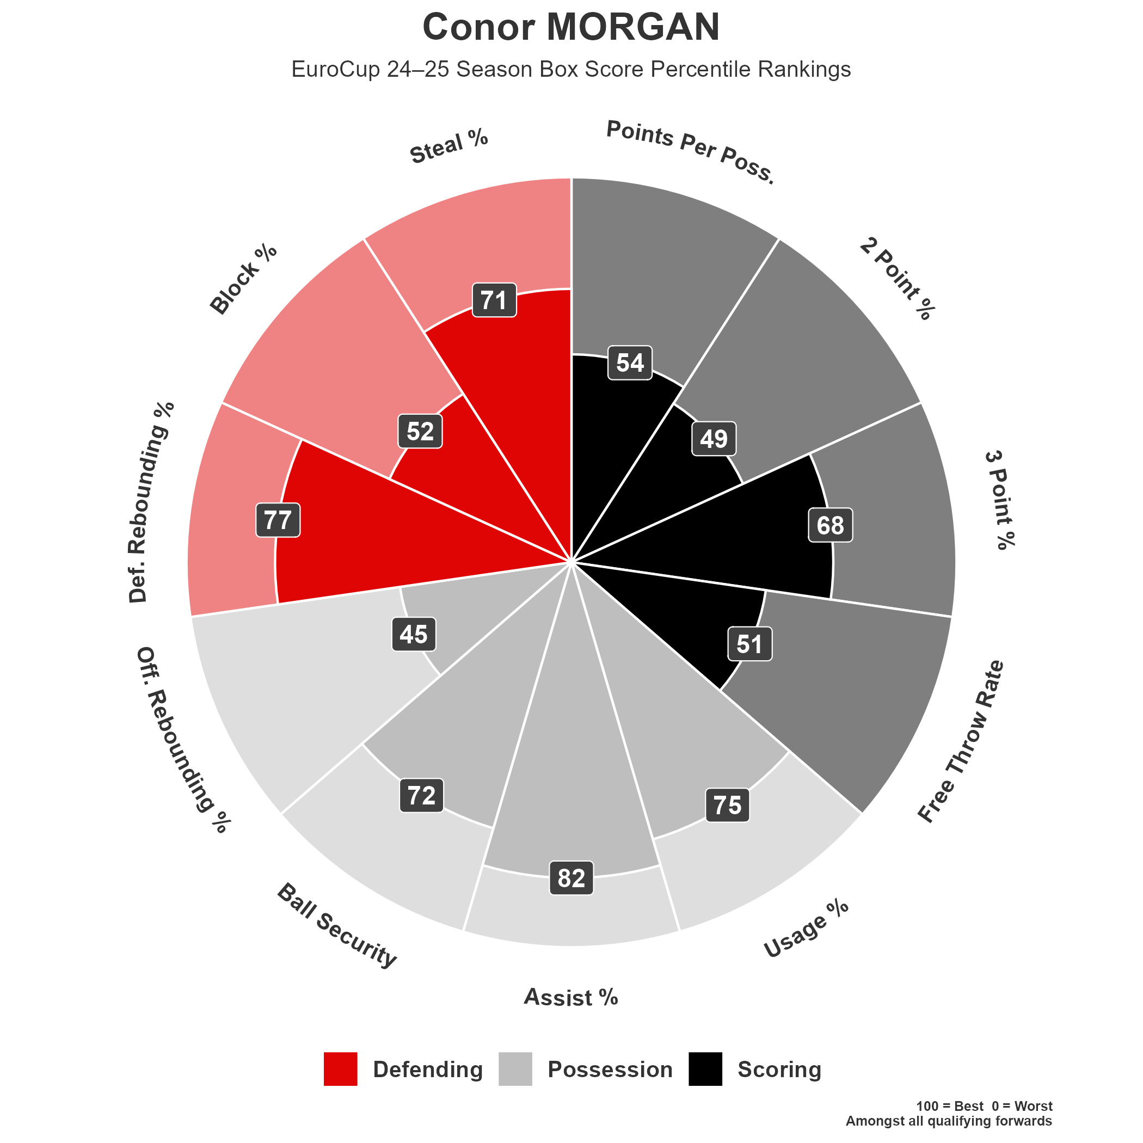
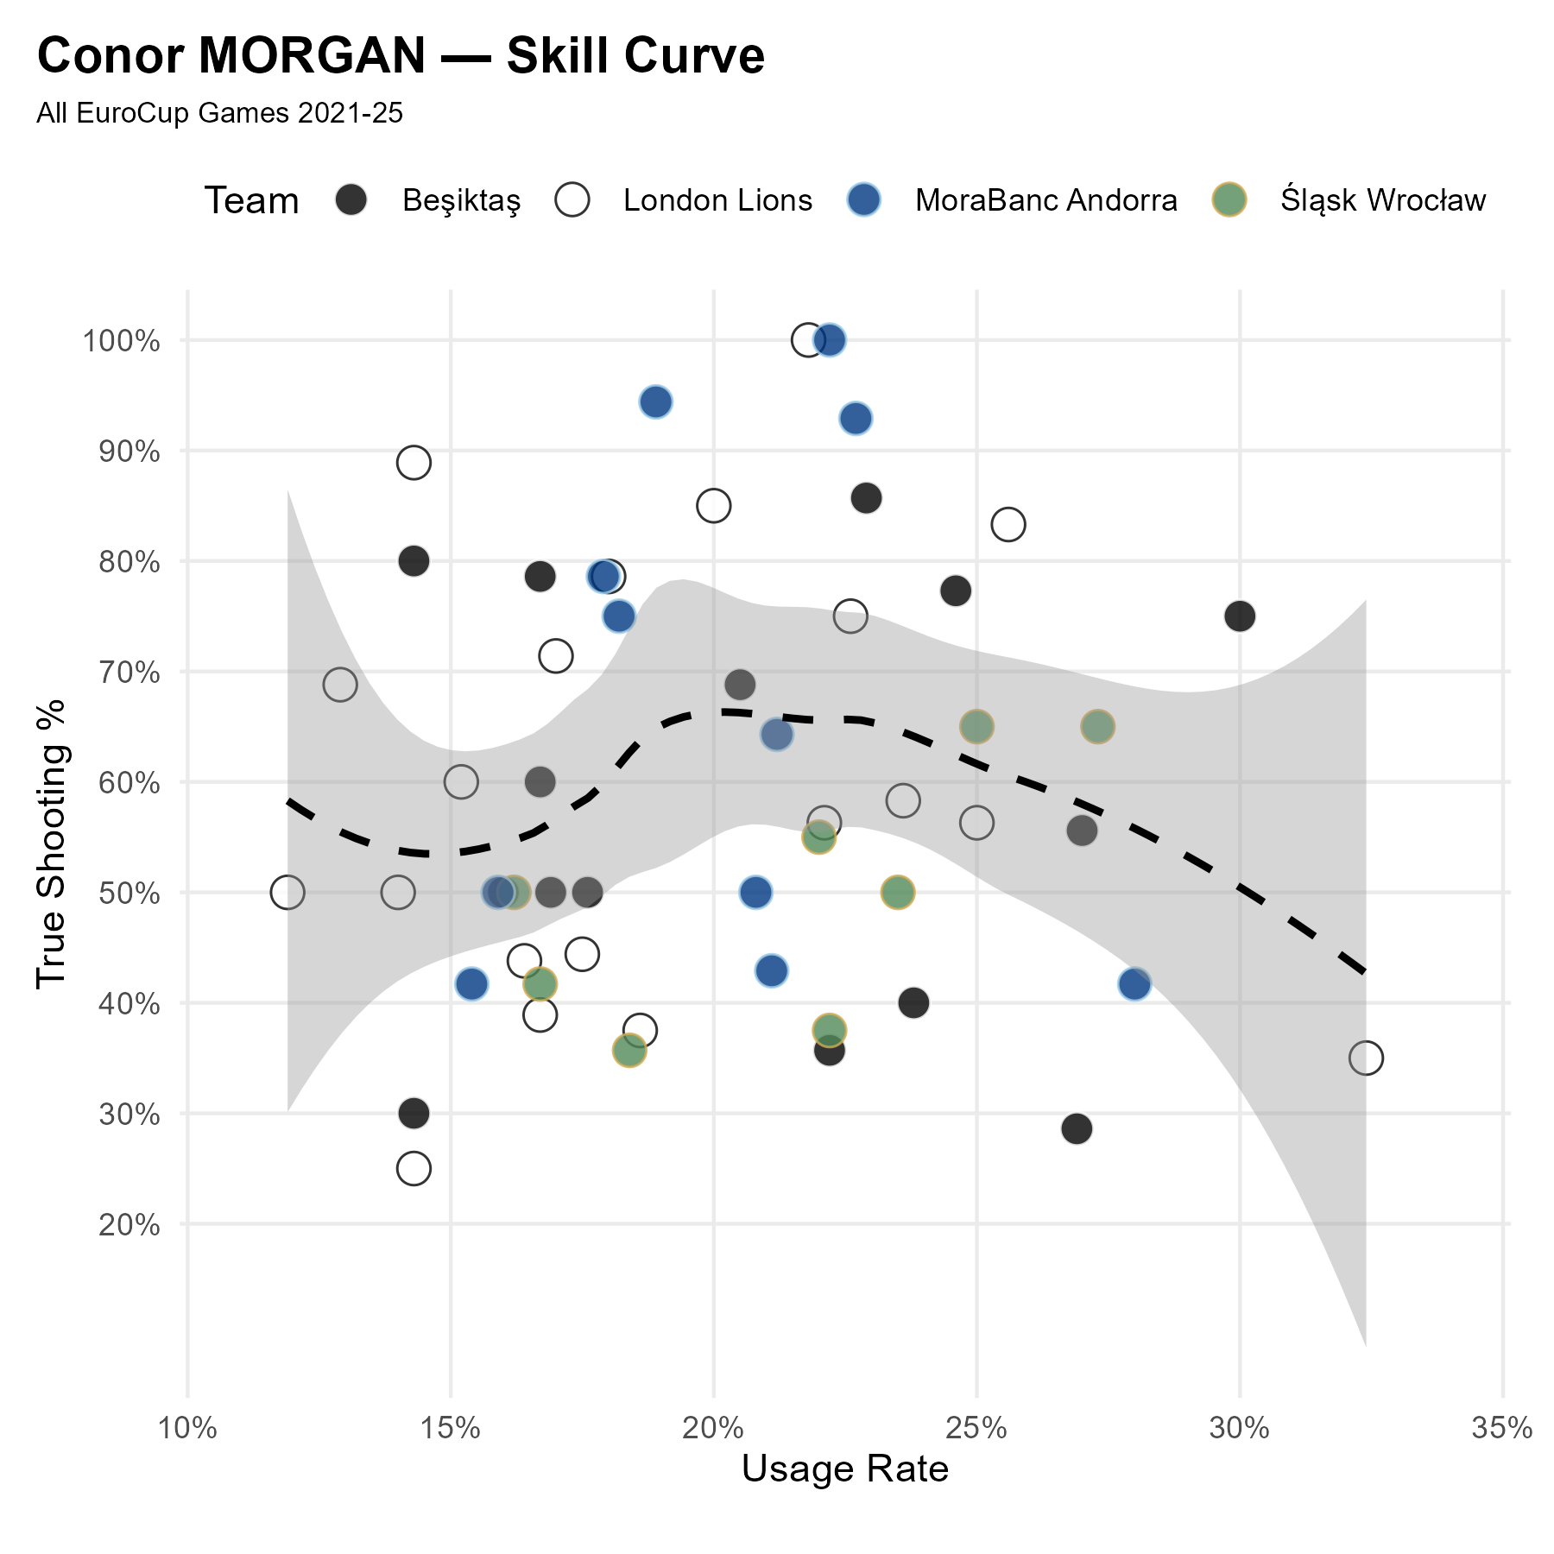
Conor MORGAN | PF | #9
Profile

Slide 17
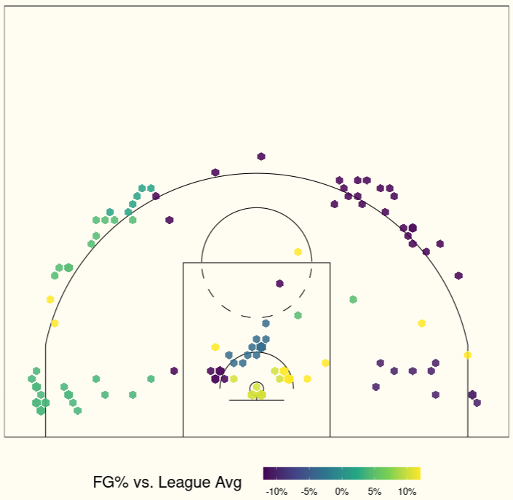
Conor MORGAN | PF | #9
Shooting Chart
EuroCup 2024/25

Slide 18
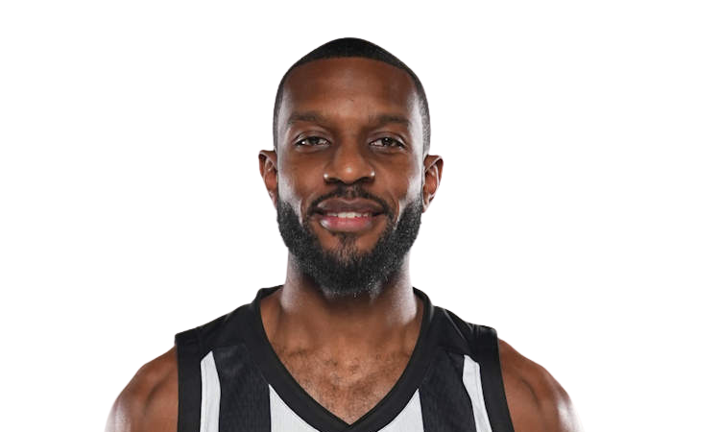
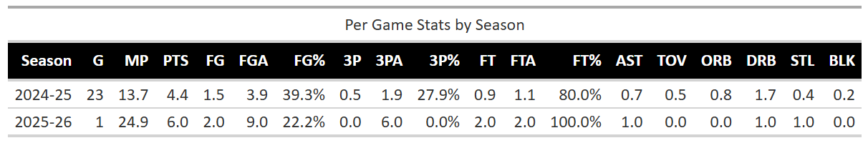
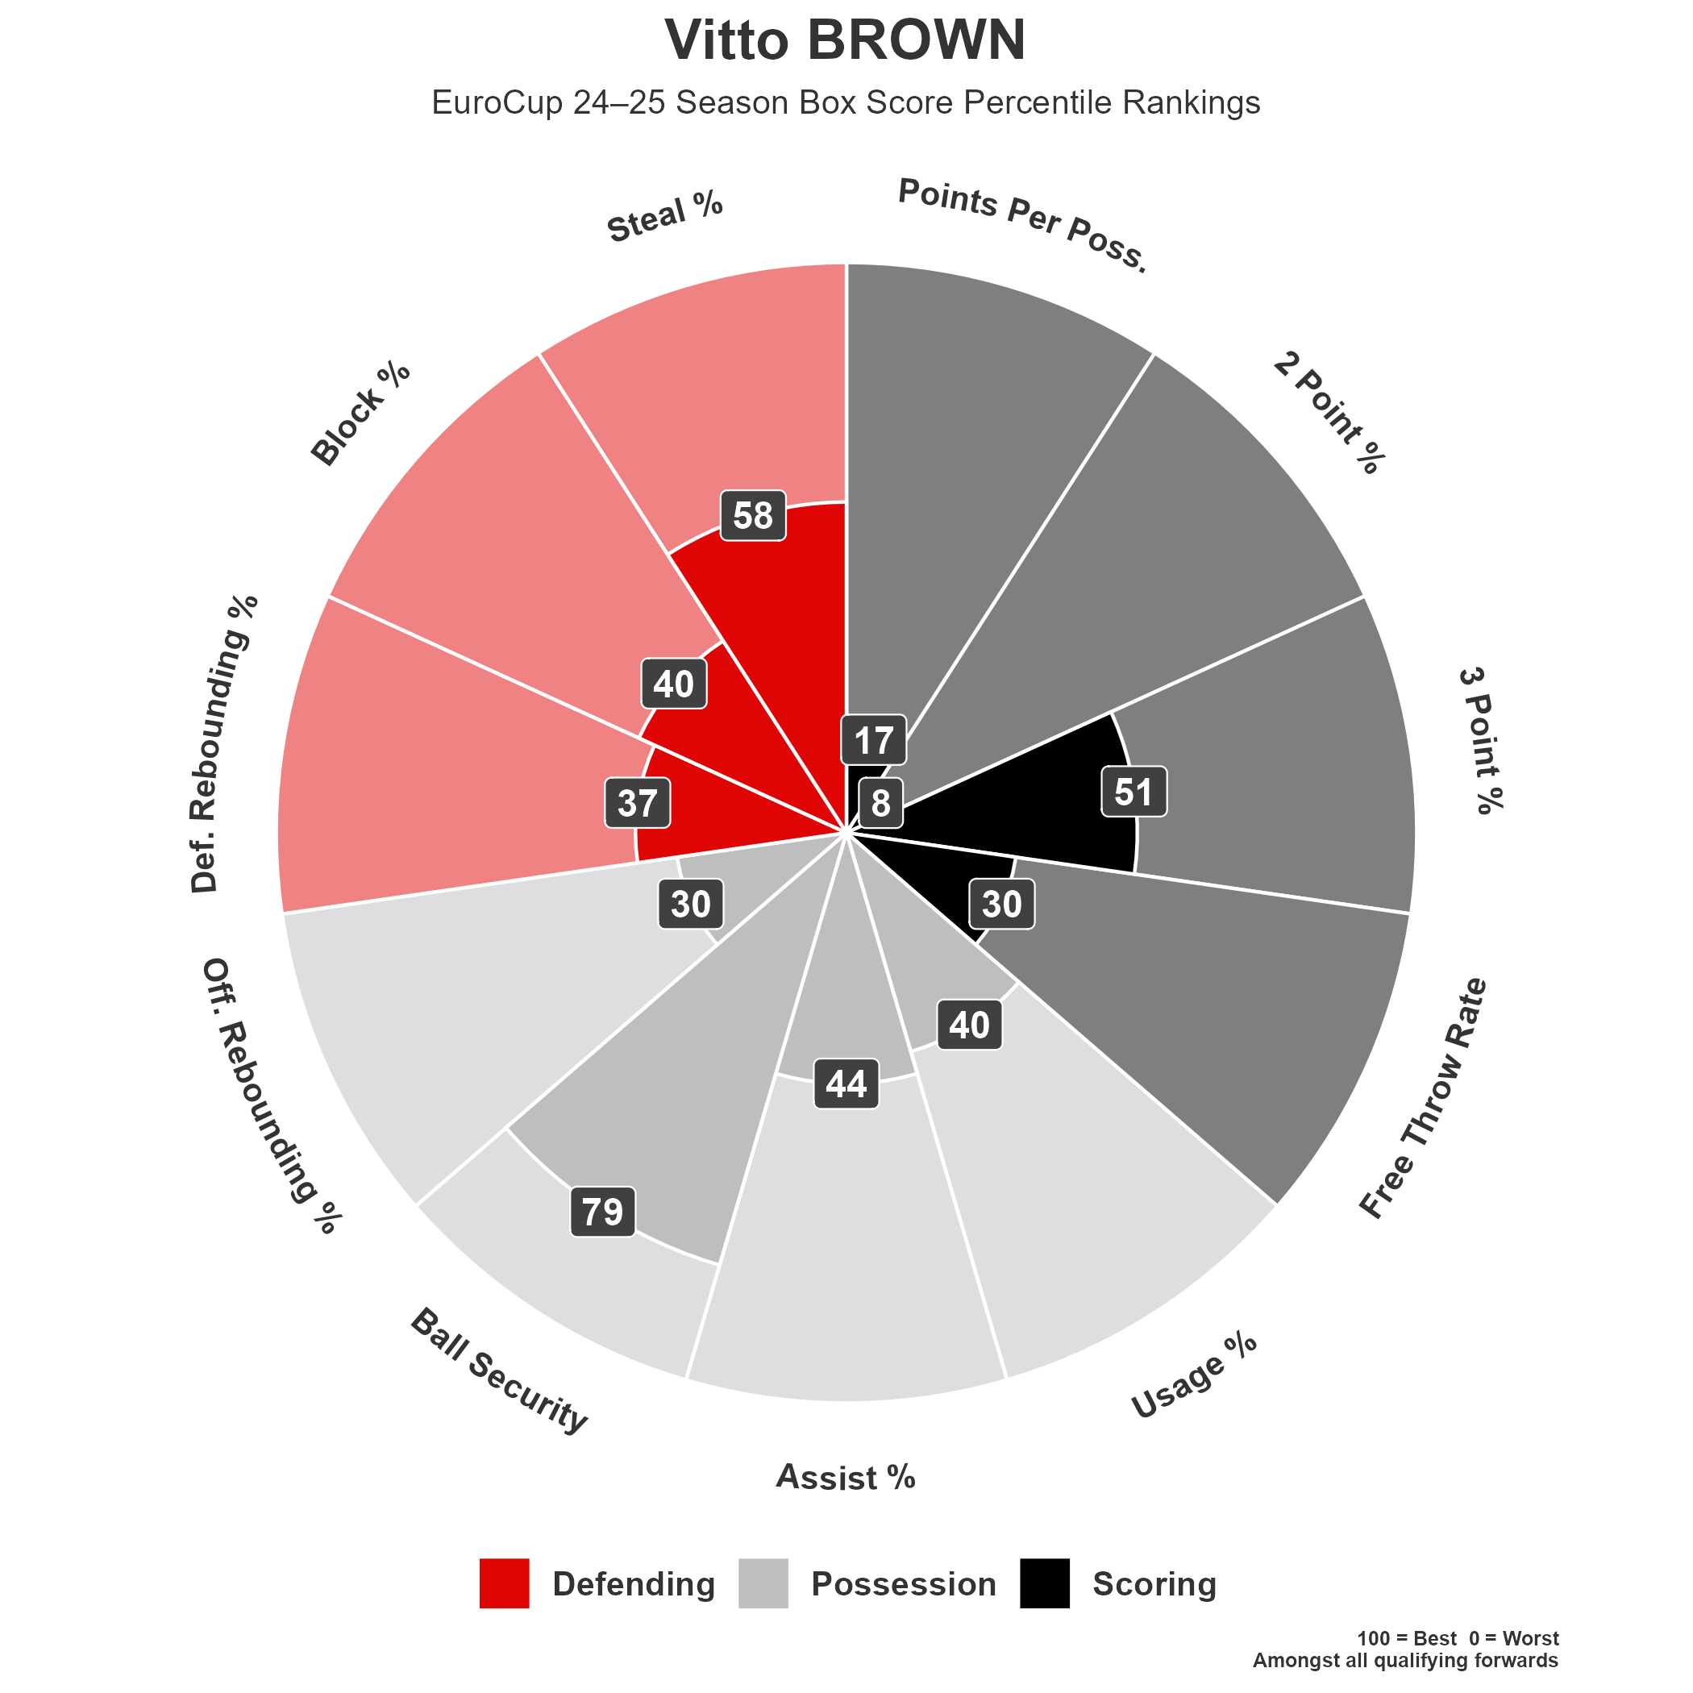
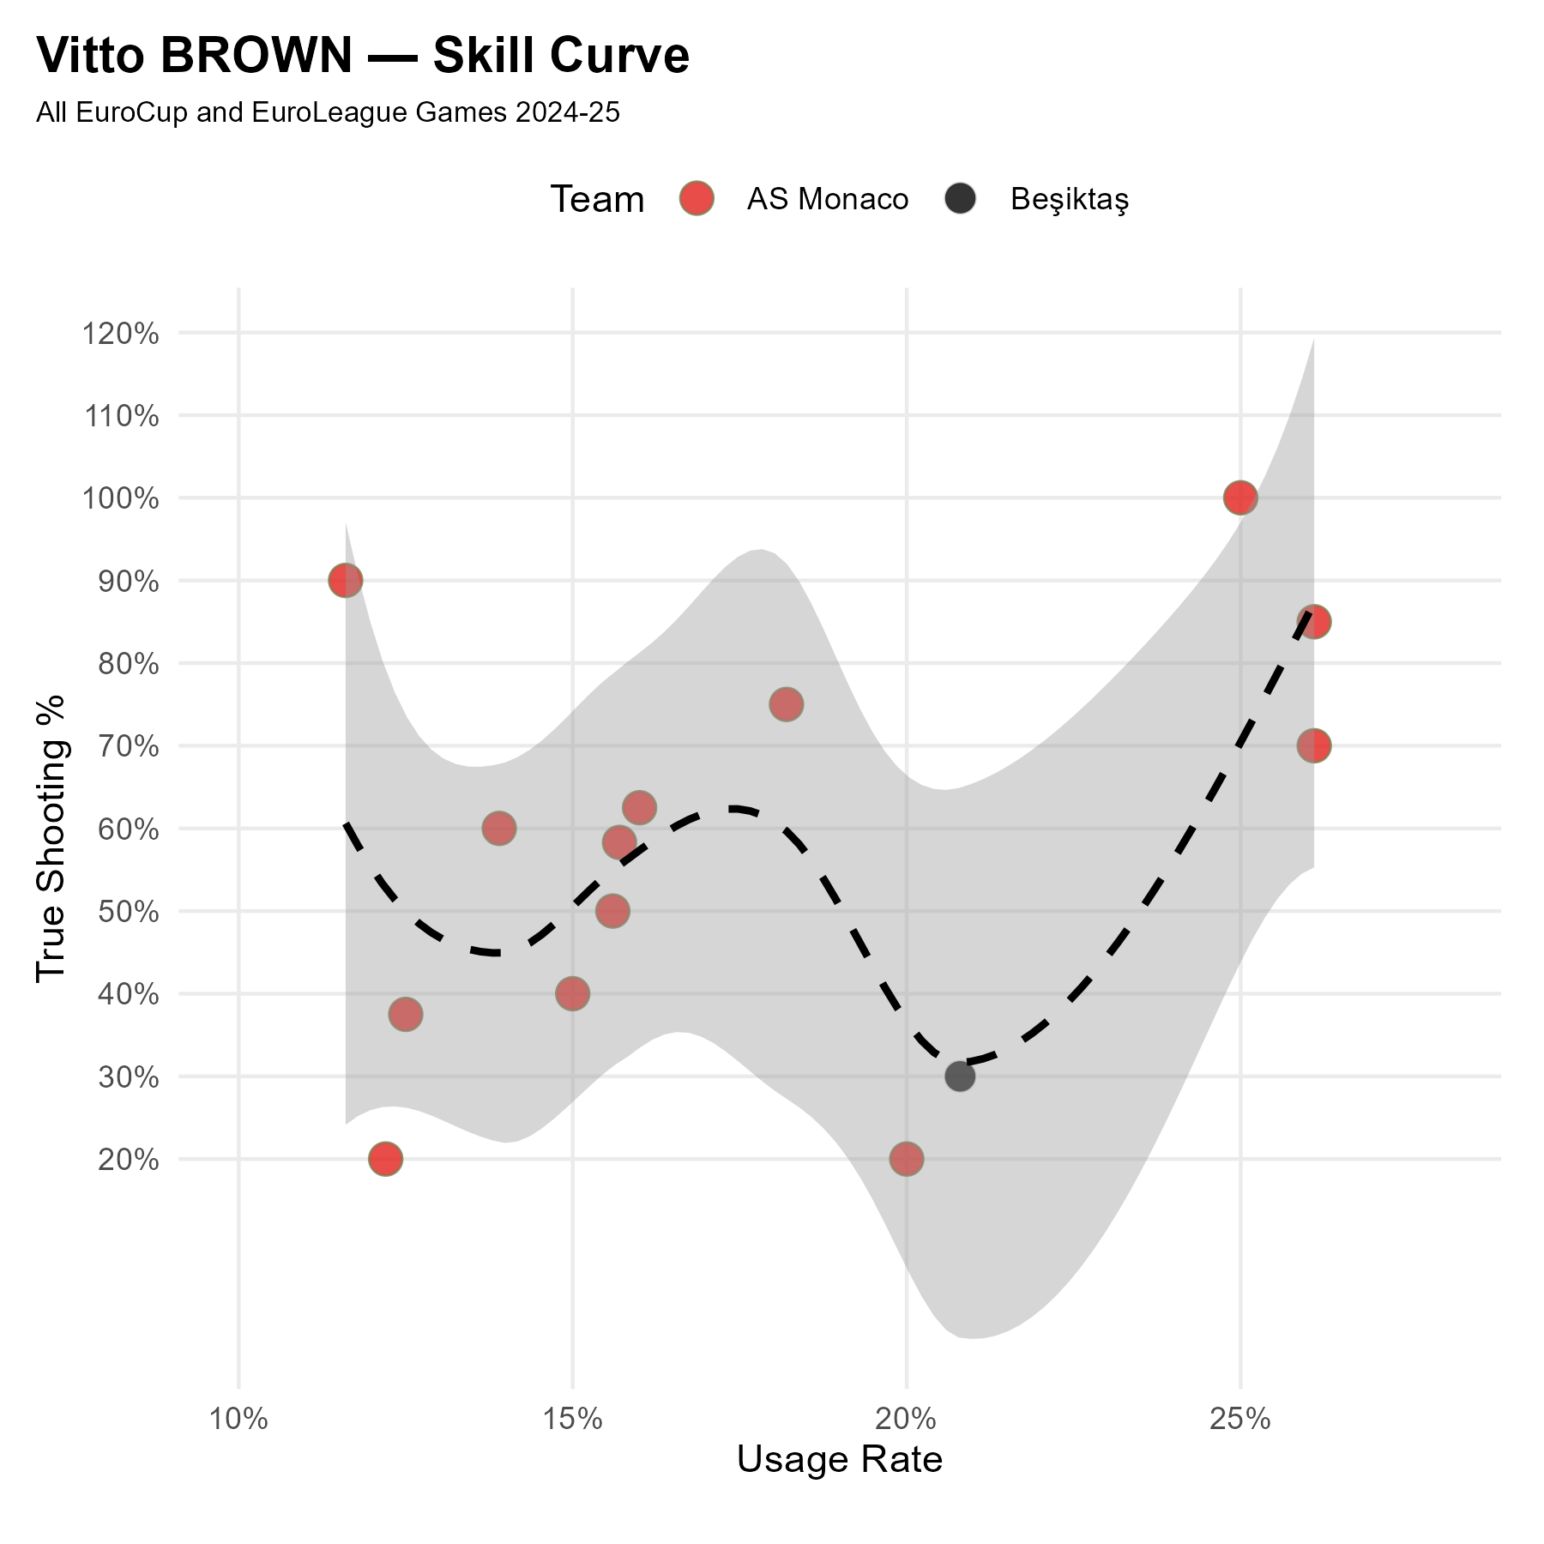
Vitto BROWN | PF | #33
Profile
2024/25 Box Score Percentile Rankings (EuroLeague)

Slide 19
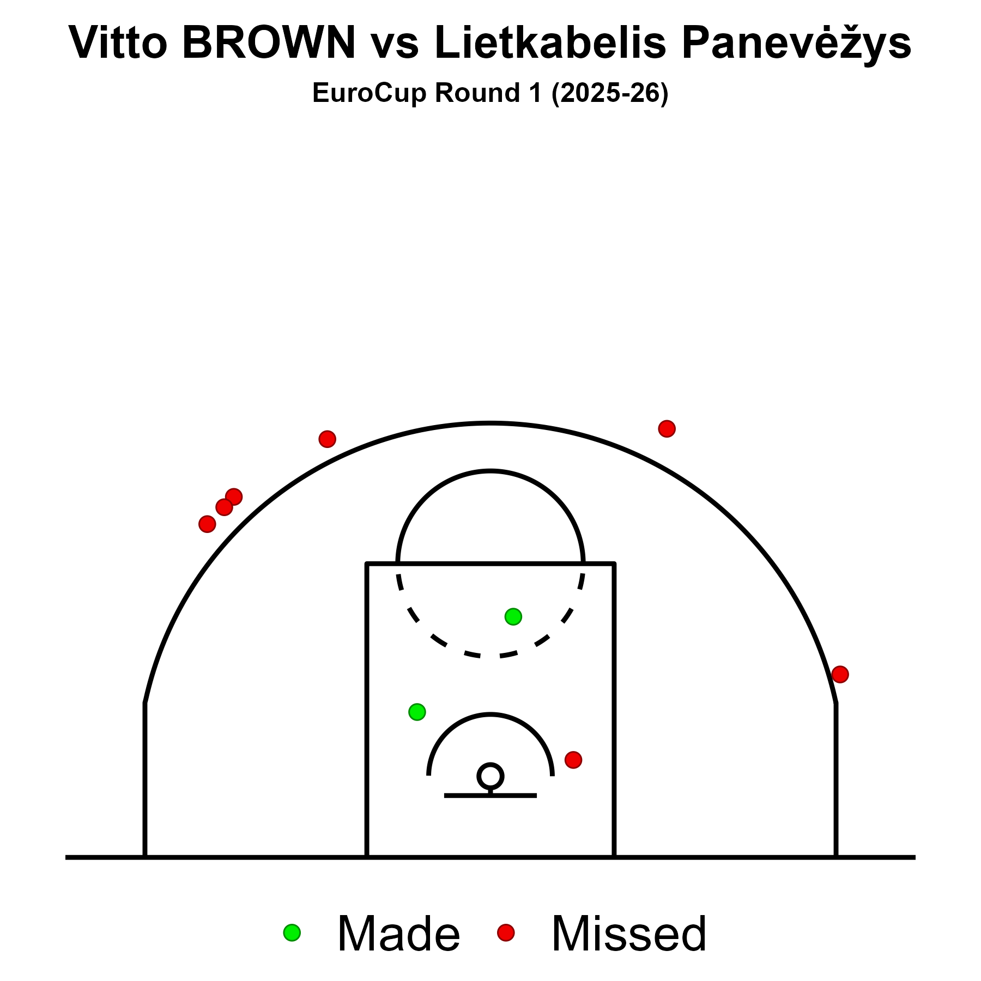
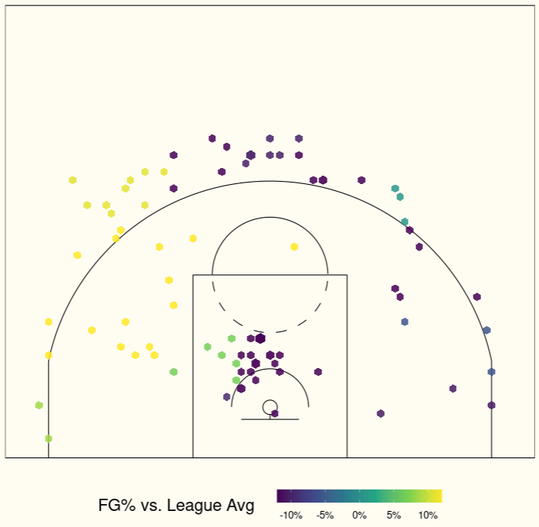
Vitto BROWN | PF | #33
Shooting Charts
EuroLeague 2024/25

Slide 20




Ismael KAMAGATE | C | #4
Profile
2024/25 Box Score Percentile Rankings (LBA)

Slide 21

Ismael KAMAGATE | C | #4
Shooting Chart

Slide 22




Ante ZIZIC | C | #41
Profile
2024/25 Box Score Percentile Rankings (EuroLeague)

Slide 23


Ante ZIZIC | C | #41
Shooting Charts
EuroLeague 2024/25

